Slide 1
Crop
Sciences
Ana Aviles, Melanie Garduno, Jovany Mata, Javier Sierra, and Osmar Rocha-Patino

Slide 2
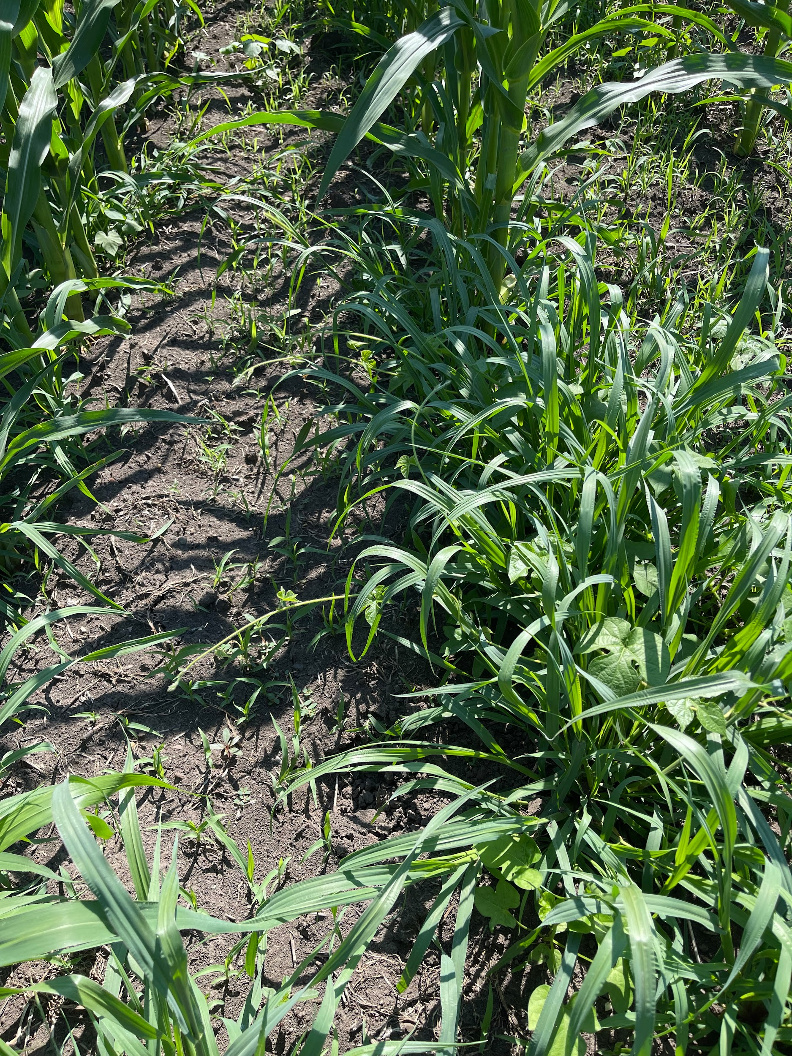
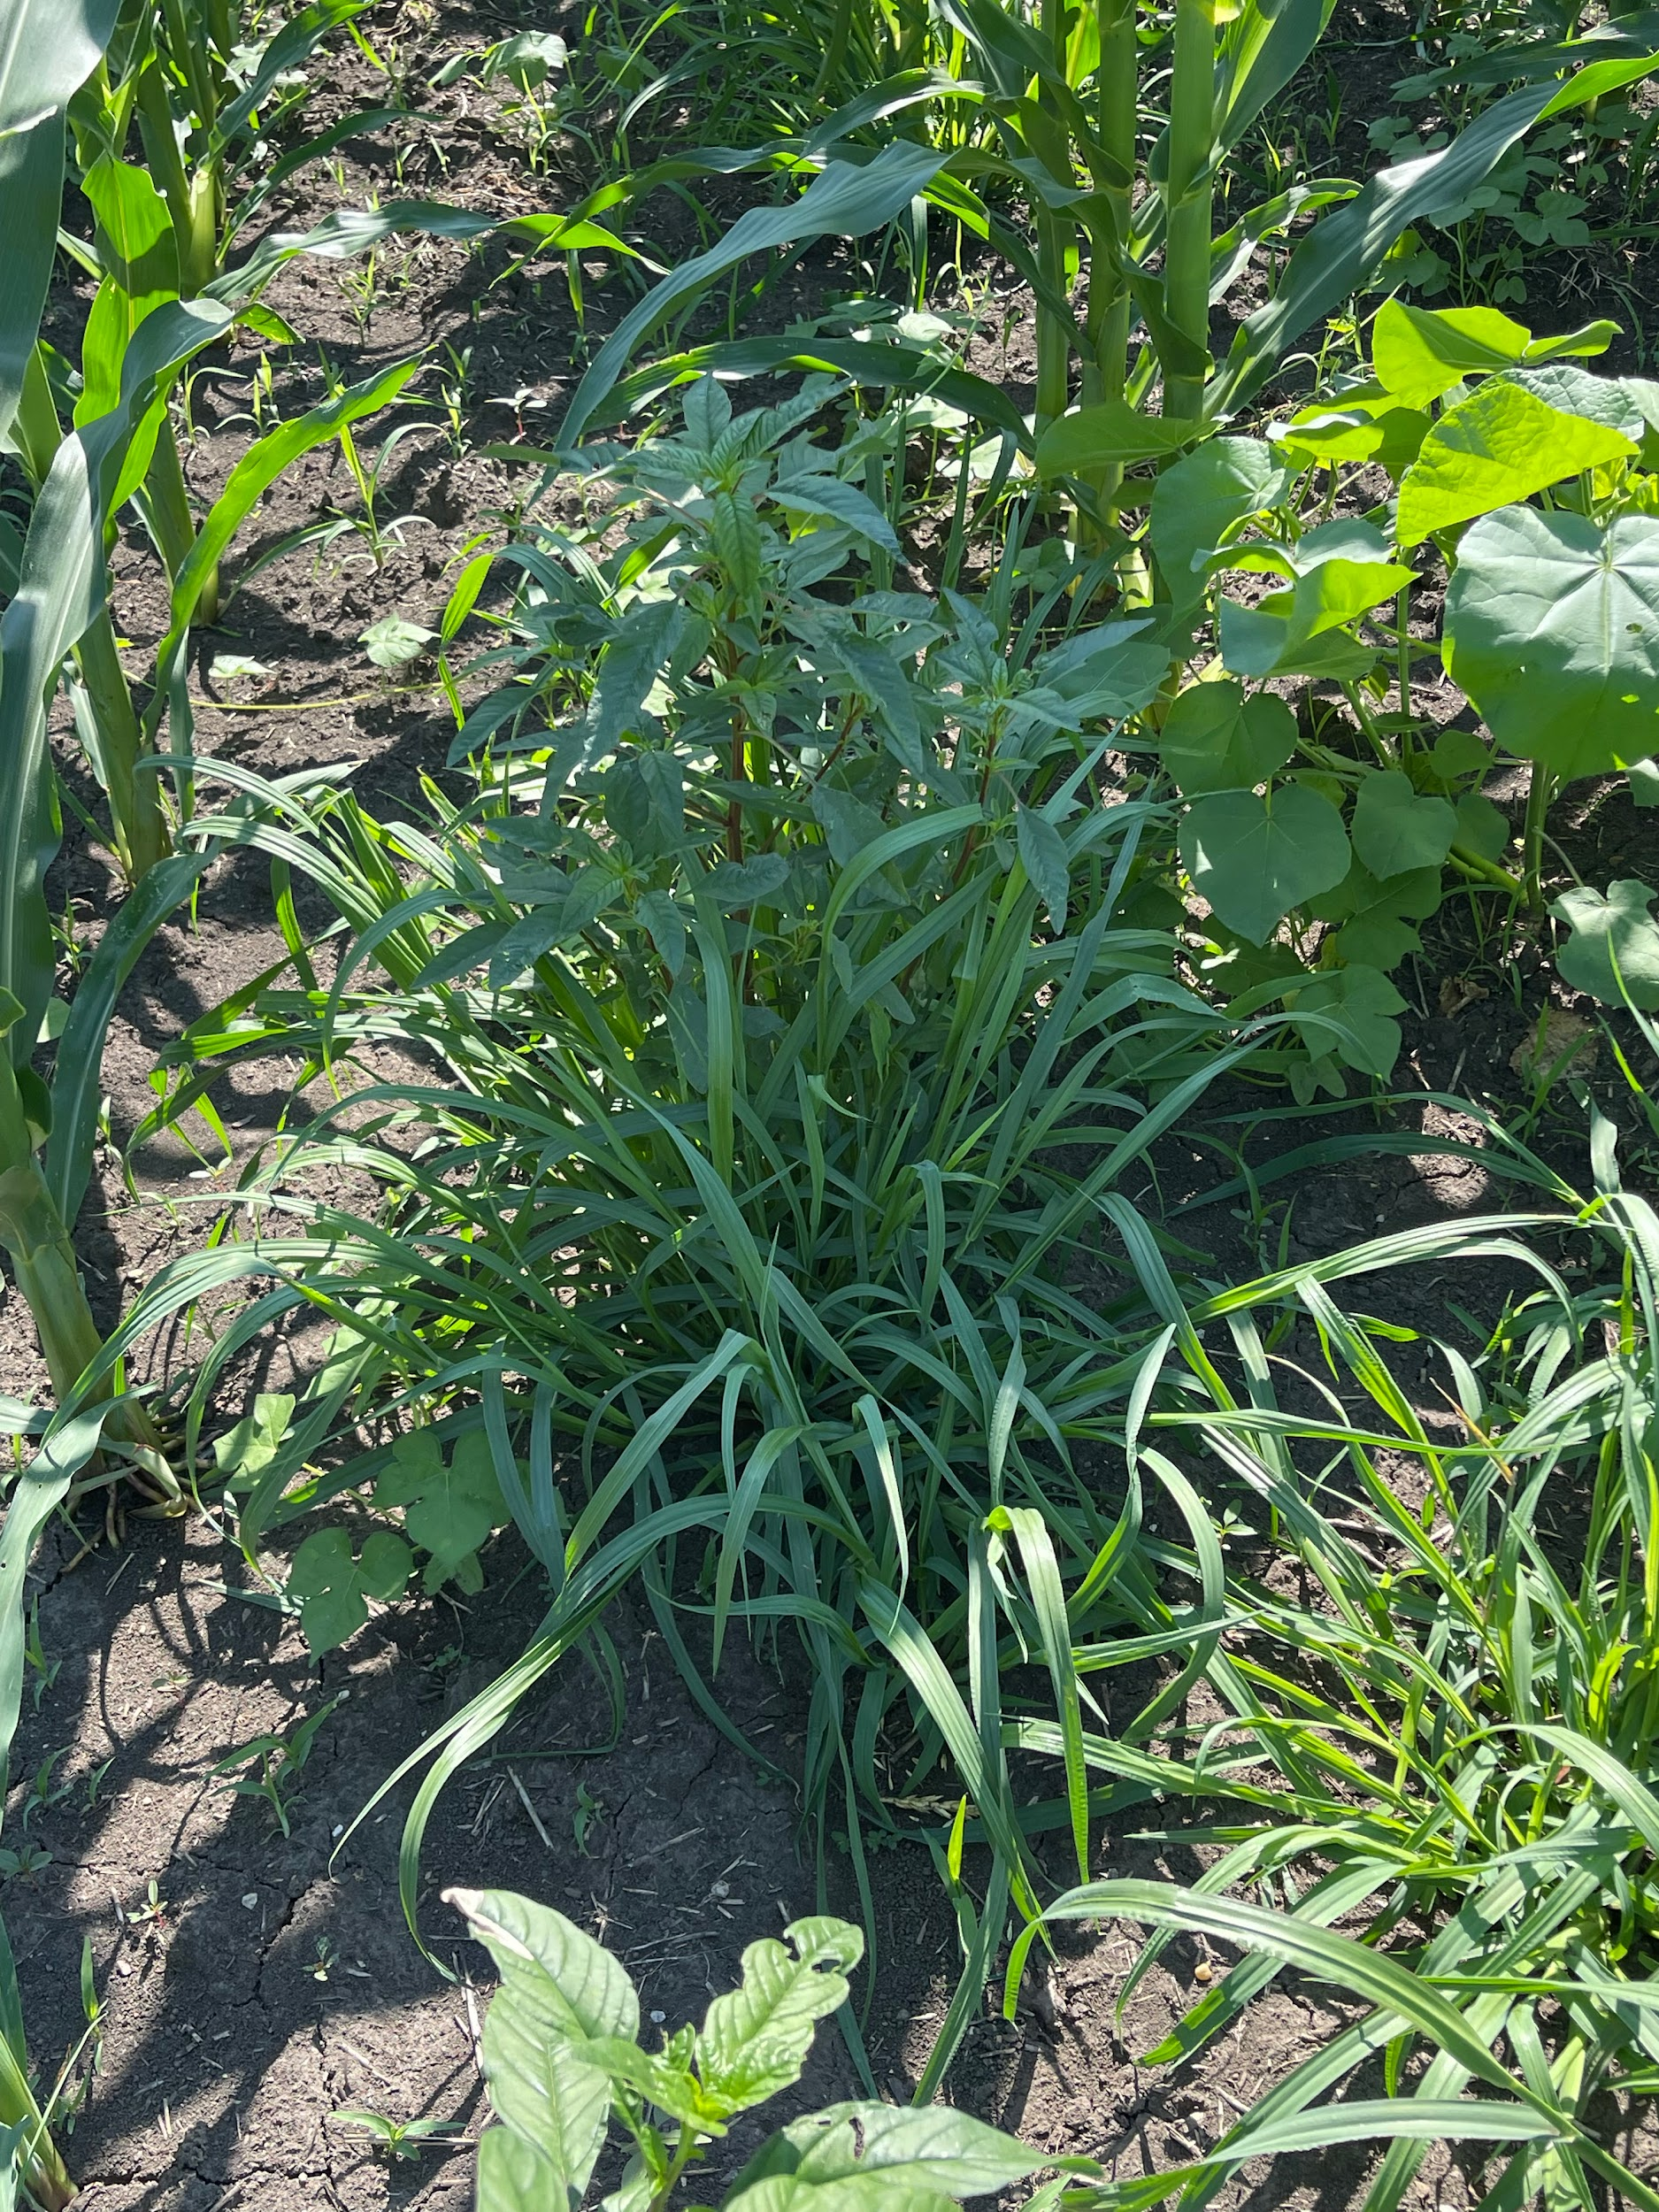
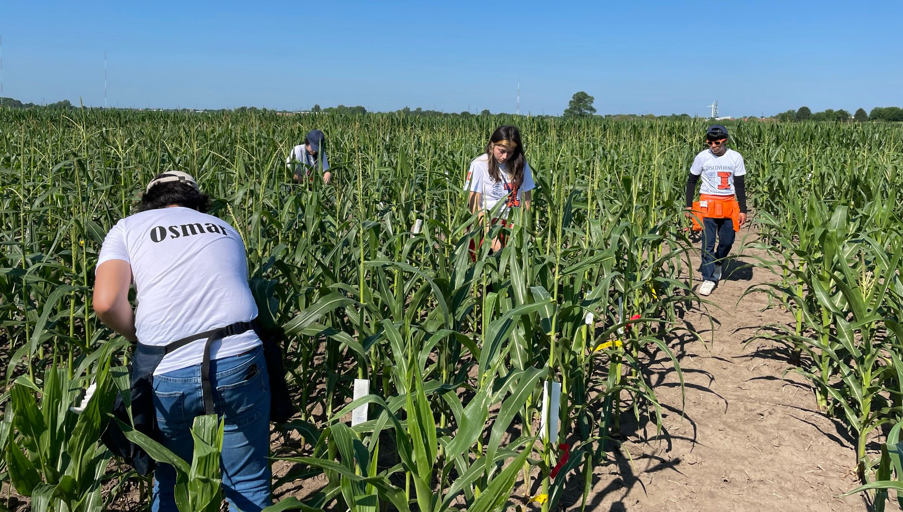
Organic vs Conventional
Organic systems are managed using environmentally friendly practices (no chemicals, healthier)
GMOs are not allowed
Uses complex rotation systems
Conserves soil health
Conventional systems use chemicals and synthetic inputs such as fertilizers, herbicides, insecticides (bad for health).
The use GMO varieties
Uses short rotation systems
May deplete soil health

Slide 3
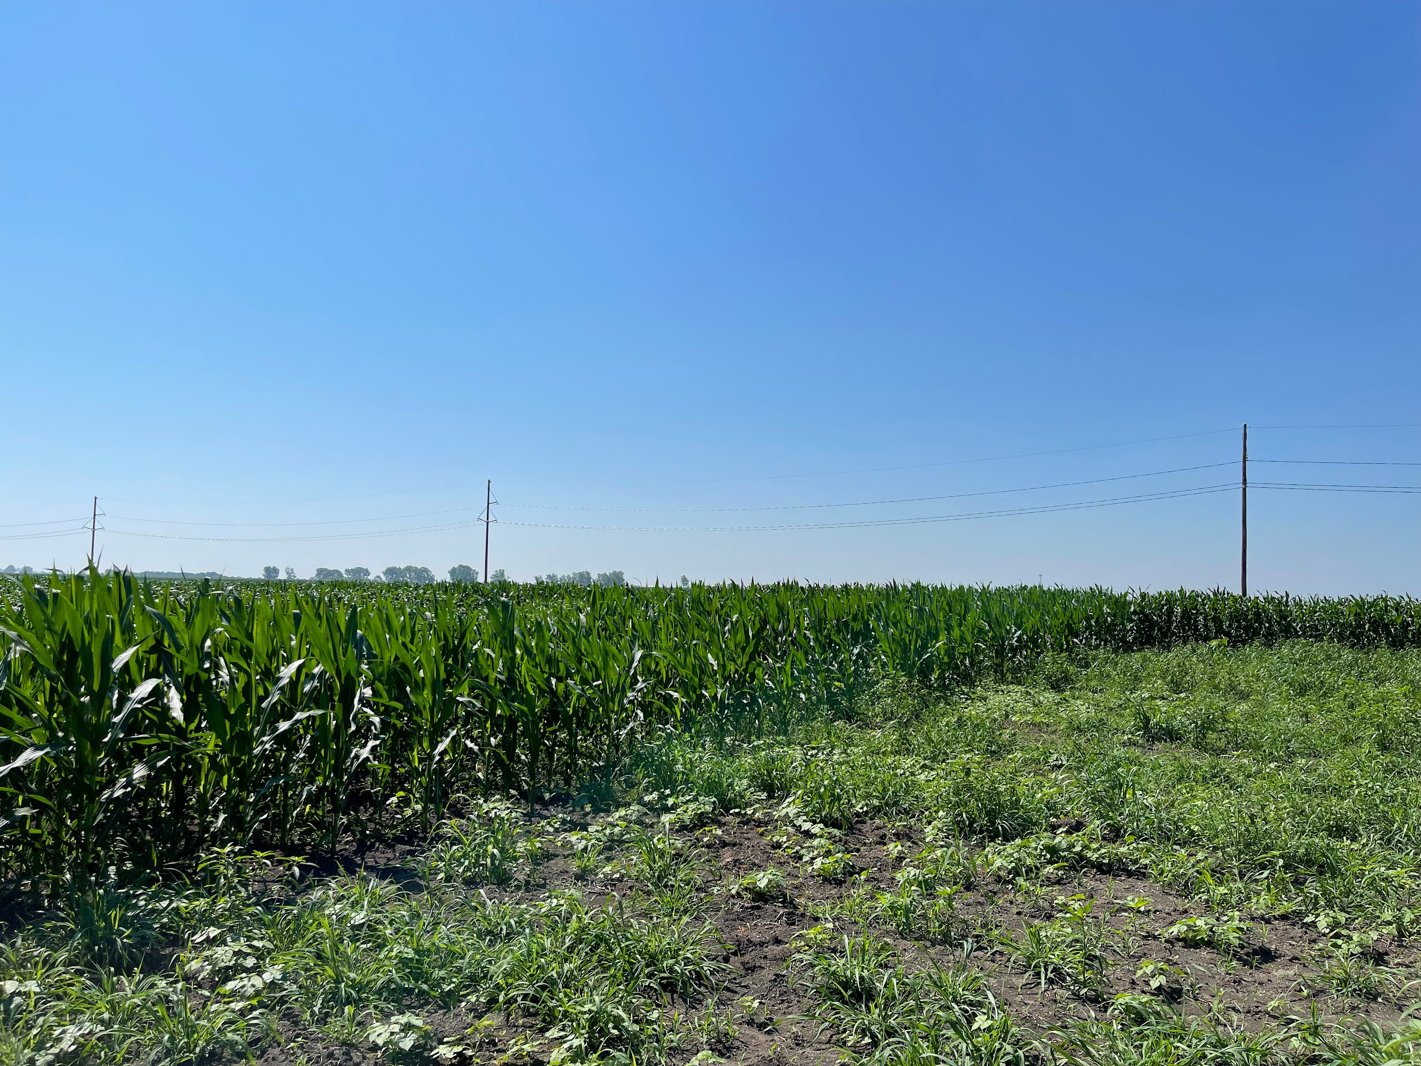
Rotational Systems
What is a rotational system?
It is the rotation of crops every cycle to help rebuild soil and control weeds using cover crops.
Here, the crops are rotated on a 4 year and 3 year based cycle
The 4 year rotation is as follows:
Corn-Soybean - Cover Crops (Legumes)- small grains
The 3 year rotation is as follows:
Corn - Soybean - small grains or cover crops (depending on the time of the season)

Slide 4
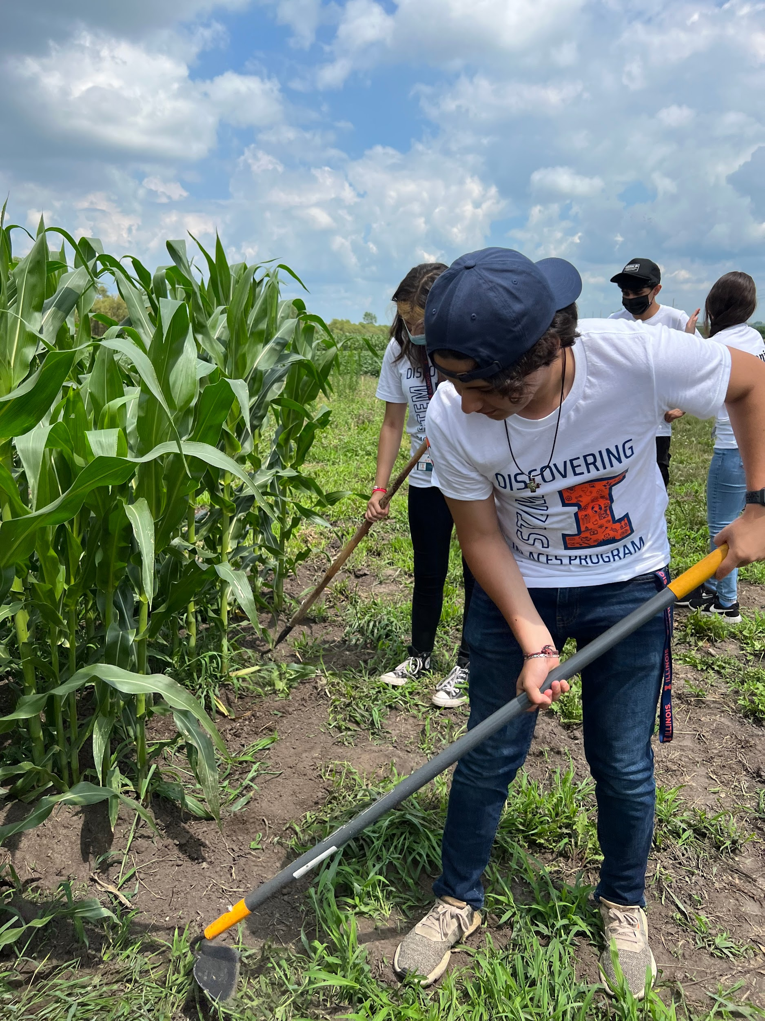
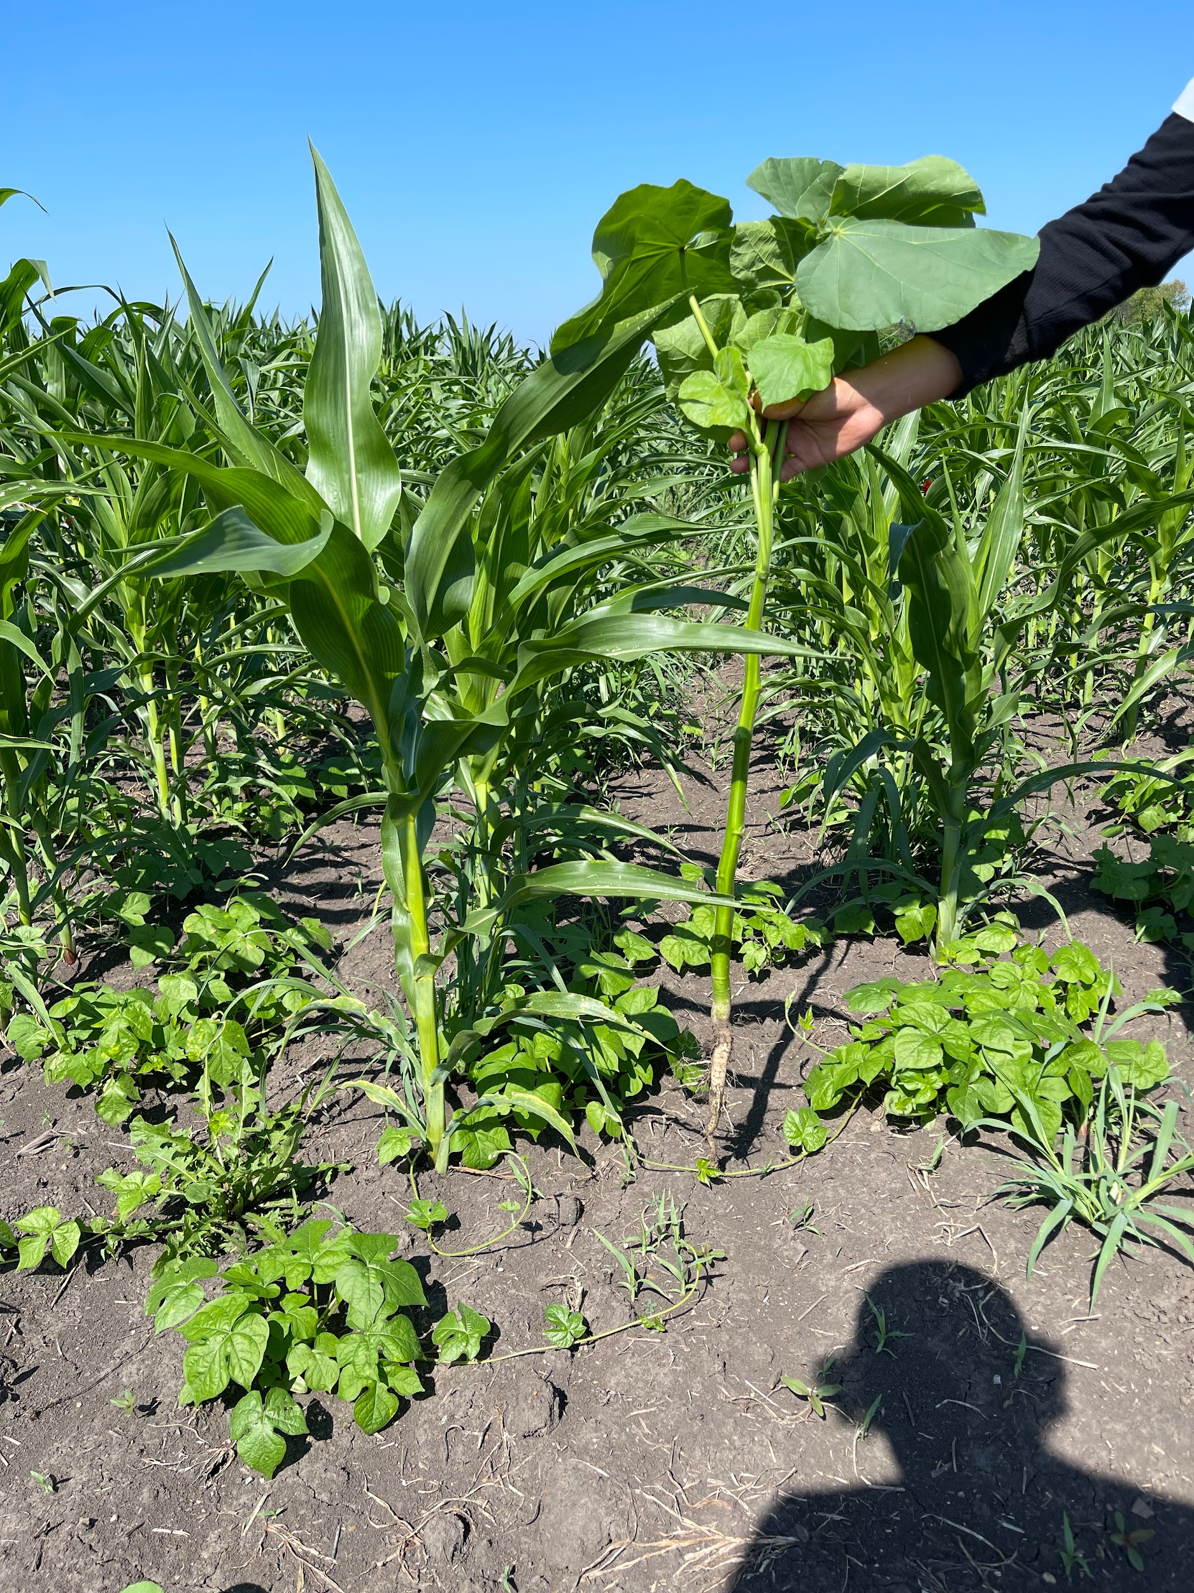
Weed Management
In organic farming, weeds are managed by crop rotation
They are also managed by removing weeds manually and mechanically
Such as using a hoe tool or cultivating the weeds
Takes more time
In conventional farming, weeds are managed and killed by using herbicides (round-up in gmo corn)
This can are toxic to the environment
They cause mutations that create resistant “superweeds” in the long.
Weeds can be broadleaf or grass species

Slide 5
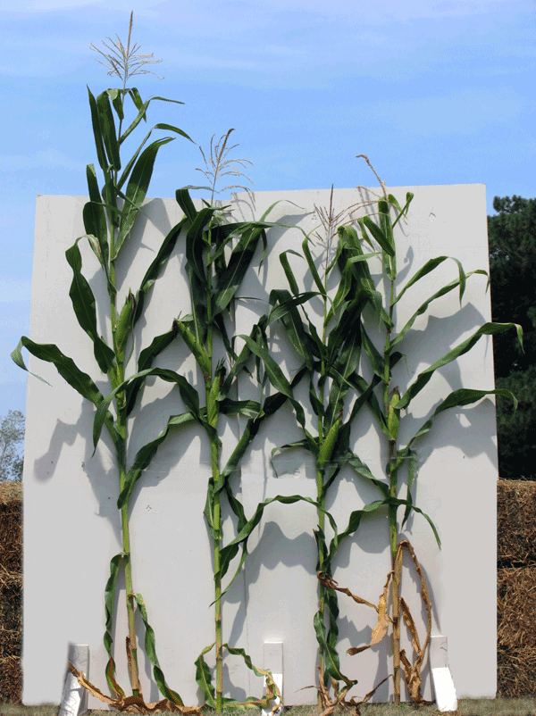
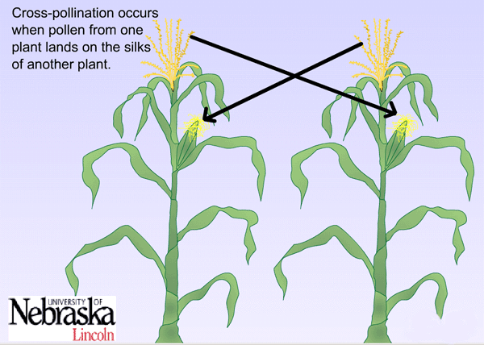
Plant Pollination
It takes 7 cycles of inbreeding in order to create a “pure line” and select the best traits a crop can have. Ex. selecting a disease resistant inbred line
Crossing - the process in which you take the pollen from one plant and apply it to another plant of the same species
Inbred - devolved by taking the pollen from the plant and applying it onto the crop growing on the plant itself. This process is known as selfing.
Hybrid - devolved by taking two inbreds and crossing with one another.

Slide 6
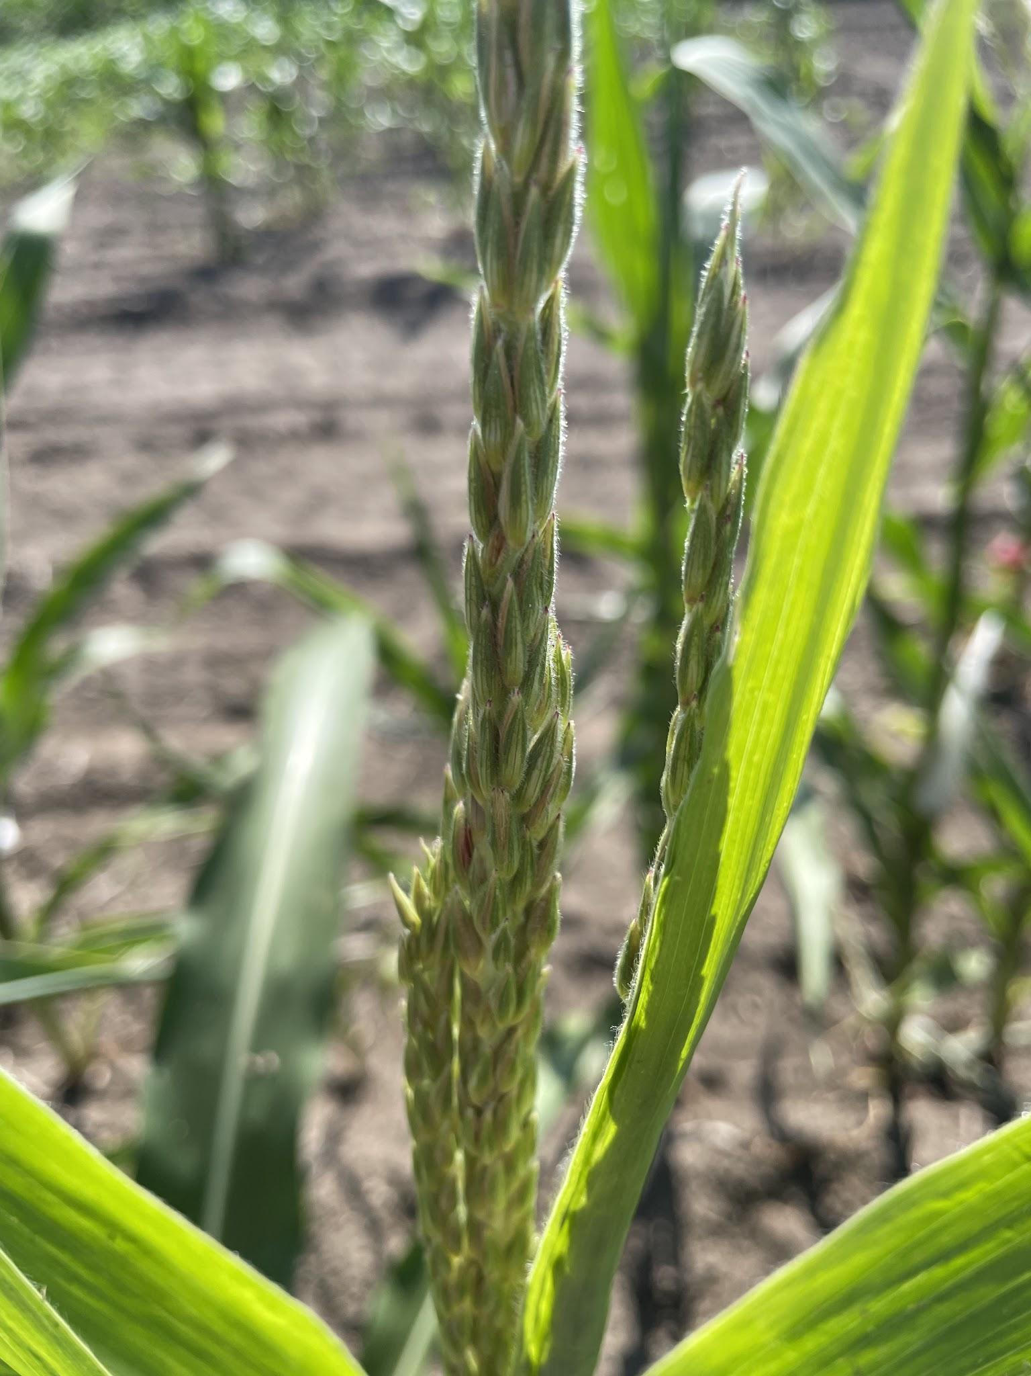
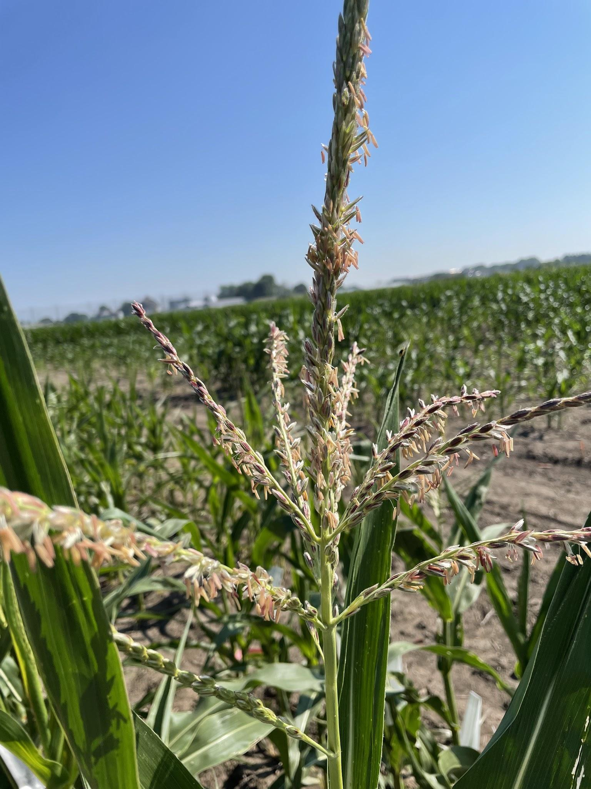
What Produces Pollen?
Anthers growing on this tassel are finished blooming, meaning pollen will begin to be released
Here the anthers have not yet sprouted and we must wait to bag them.

Slide 7
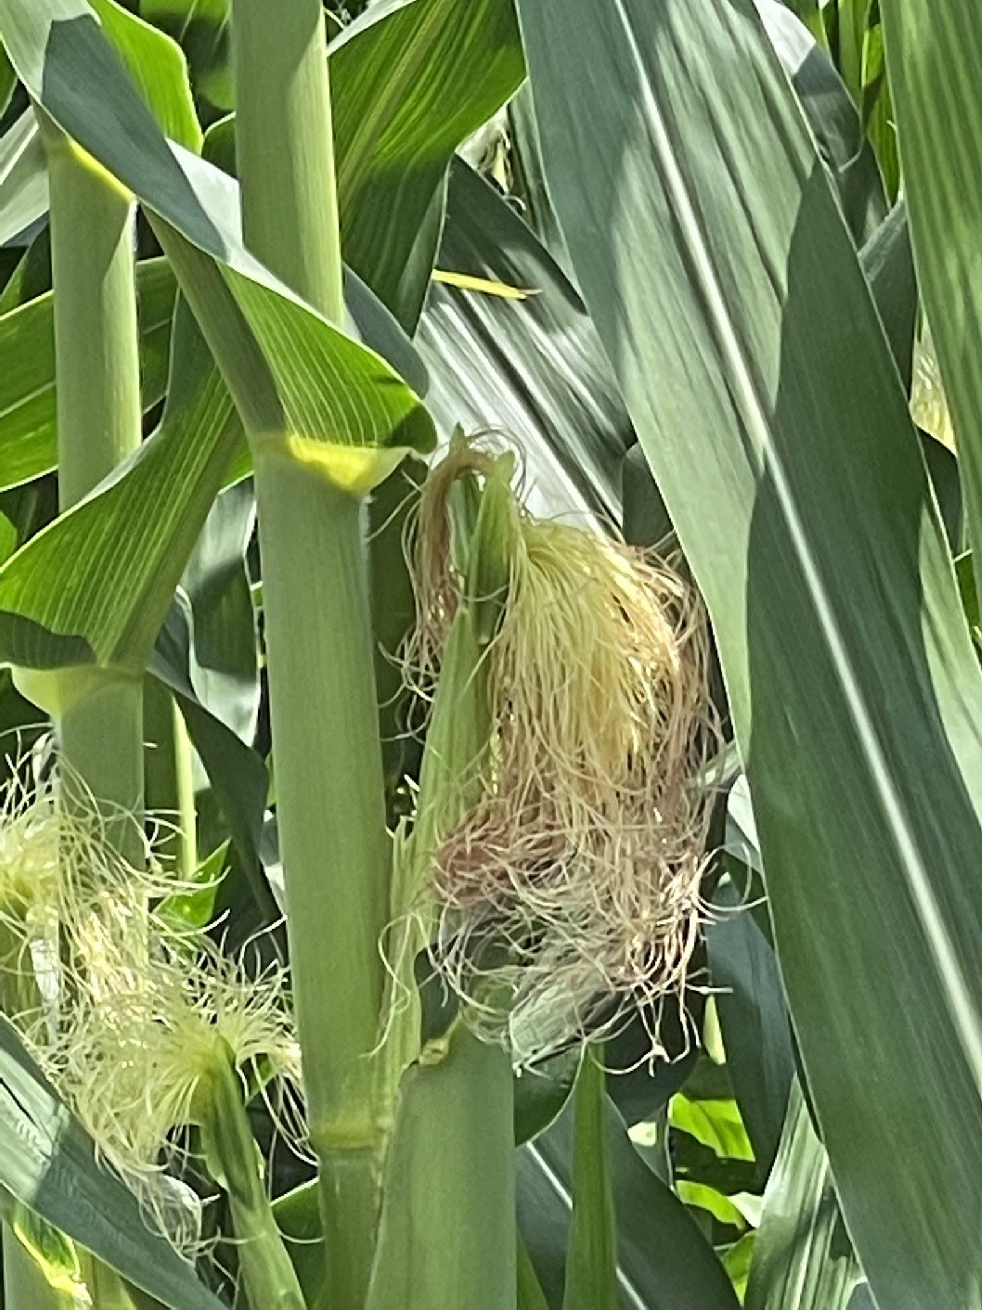
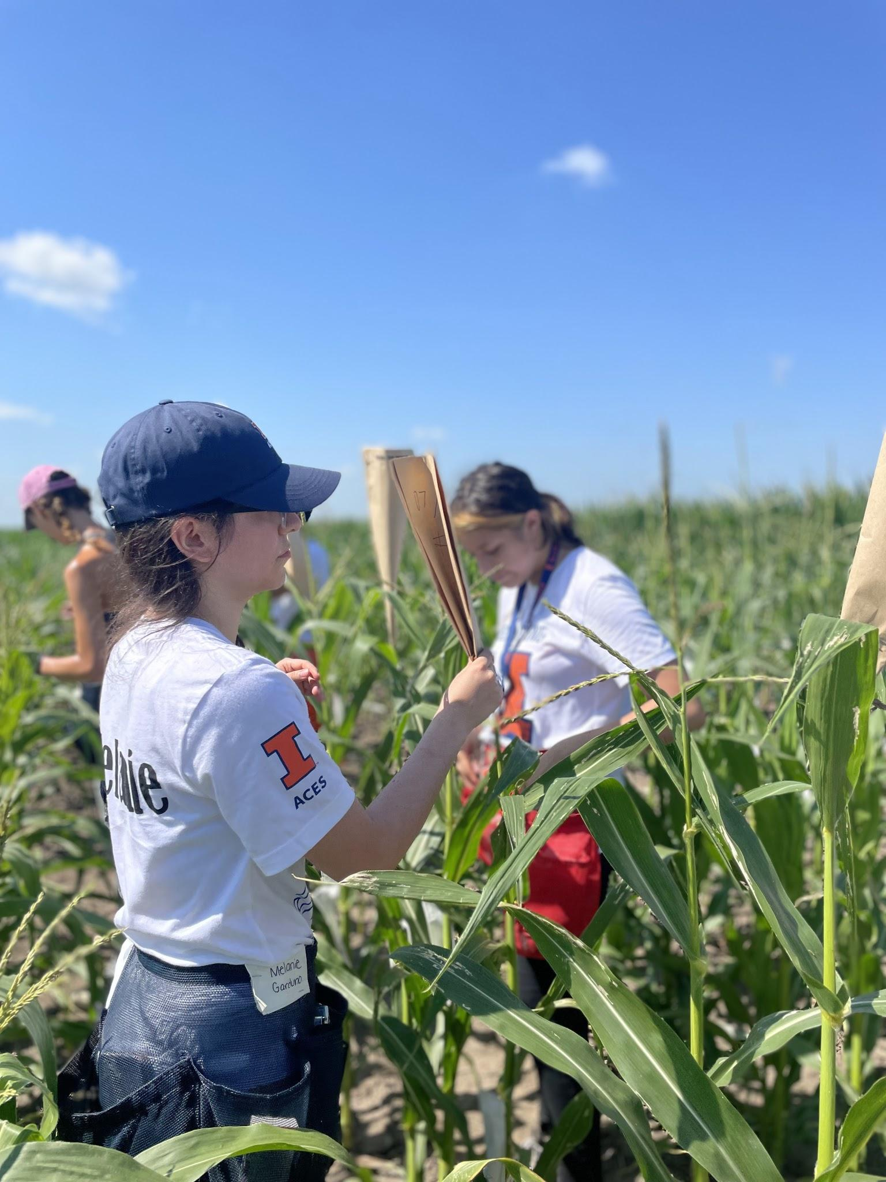
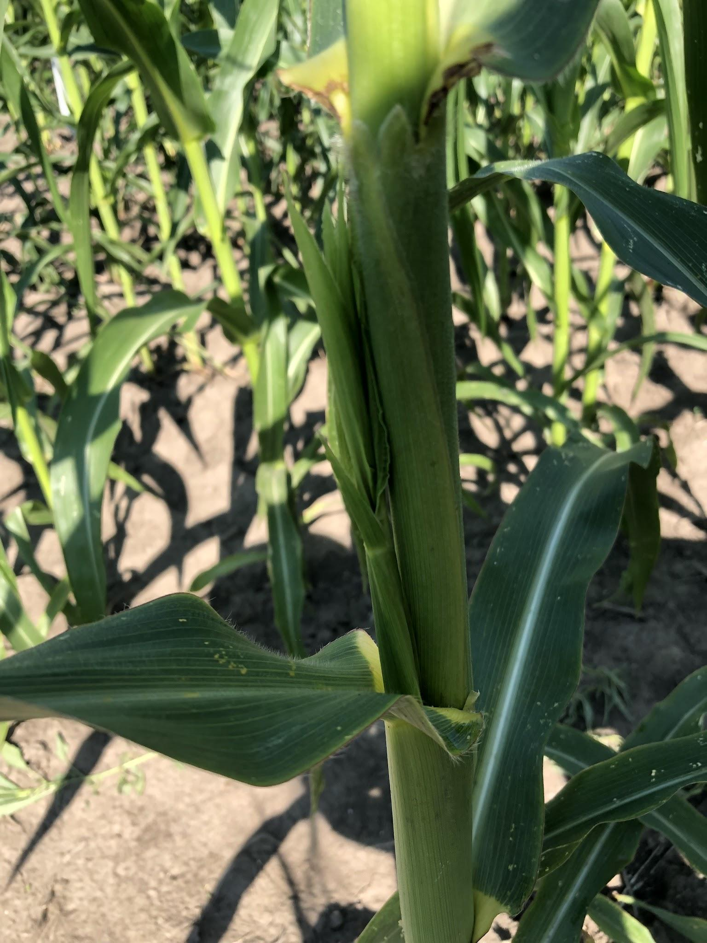
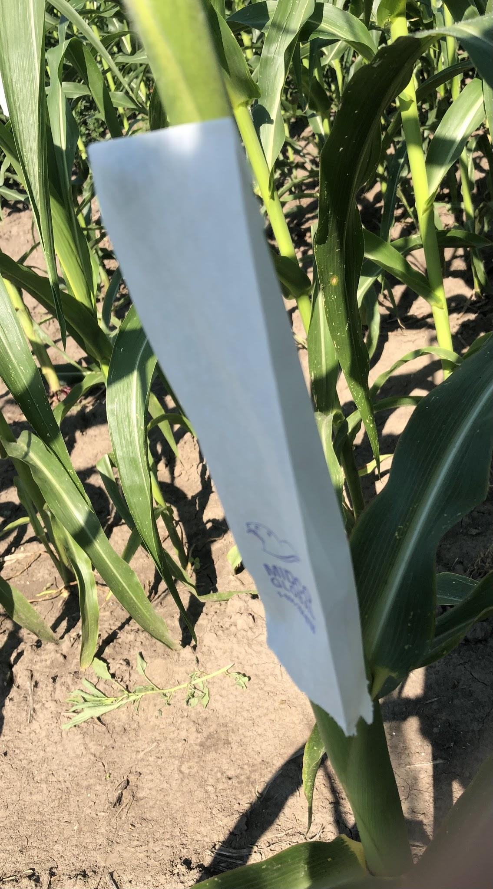
How Do We Control Pollination?
1. We place “tassel bags” over the tassels and anthers to prevent them from spreading randomly on to corn ear shoots.
Before
After
The “hairs” that come out of the ear shoots are called silk and that is where the pollen gets deposited for fertilization.
2. We place shoot bags over the entire corn ear shoot in order to properly cover the silk

Slide 8
Speed Breeding:
Haploids & Double Haploids

Slide 9
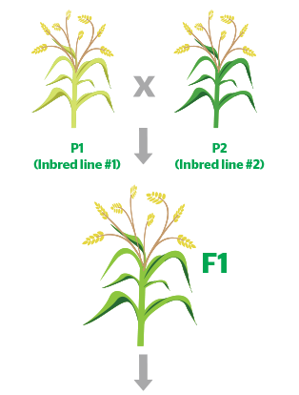
Hybrids, Inbreds & Alleles
The Importance of Parental Inbred Lines
Commercial Corn Breeding Companies
Bayer, Corteva, Syngenta
The Role of Alleles
Dominant and Recessive Alleles
Heterozygous vs Homozygous
Speed Breeding Techniques
Winter Nurseries
Haploids
Inbred Line #1
Inbred Line #2
Hybrid
Notes:
Hybrid Genetic Chart: https://kenanaonline.com/users/arcbiotech/posts/534235

Slide 10
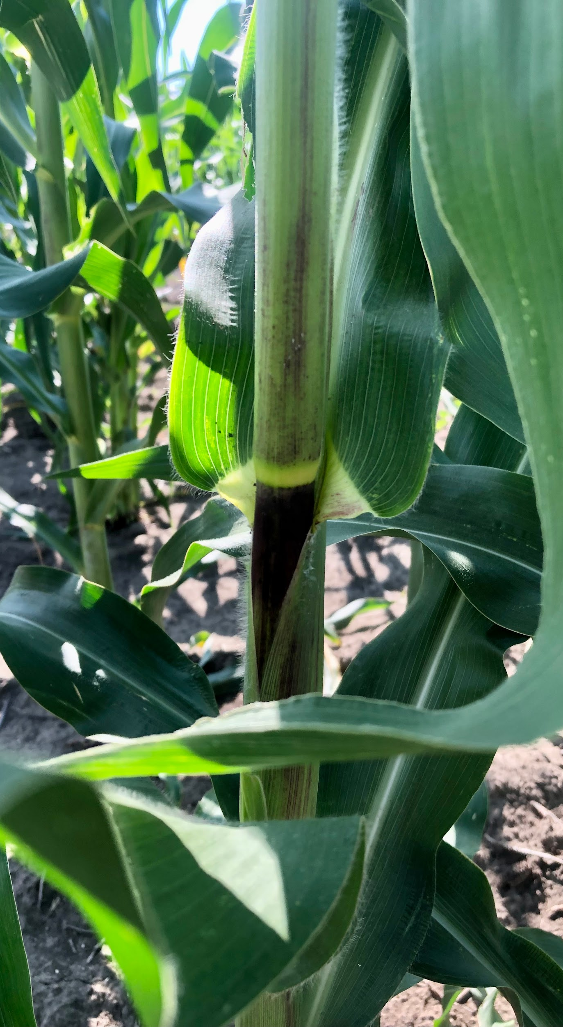
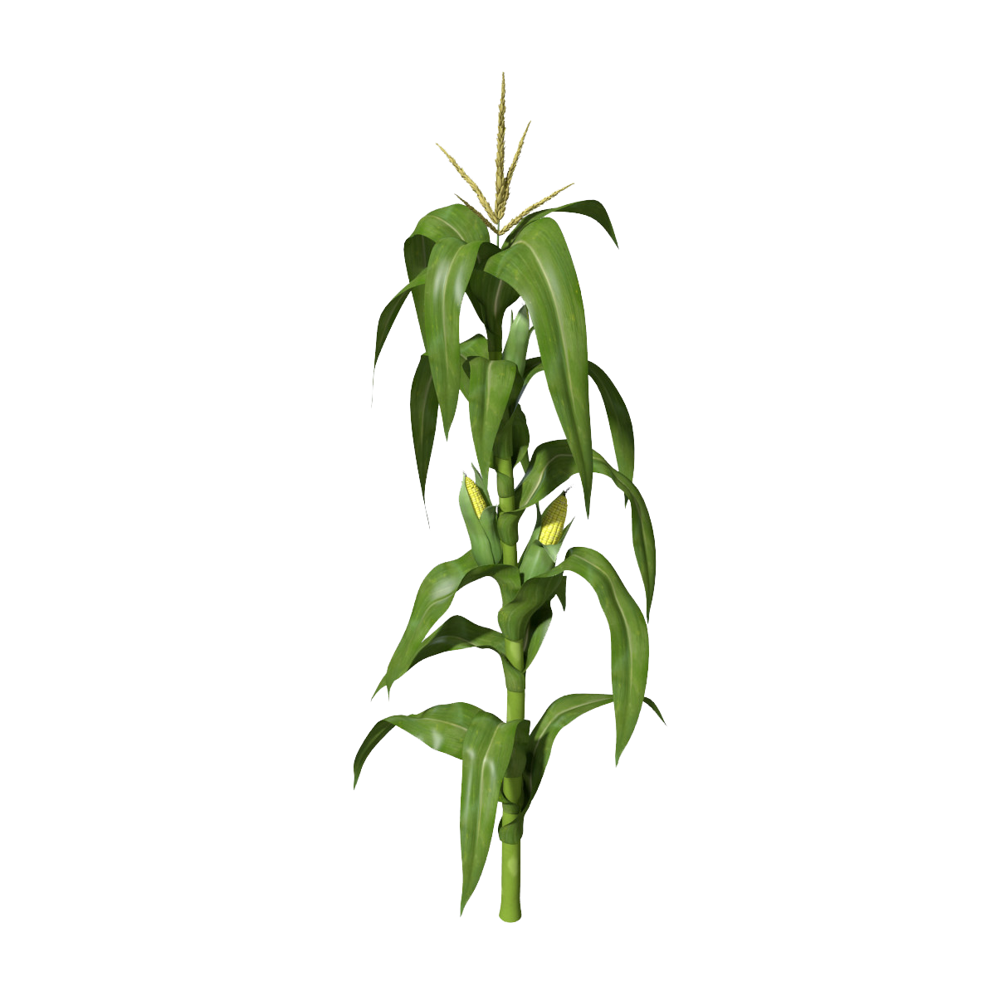
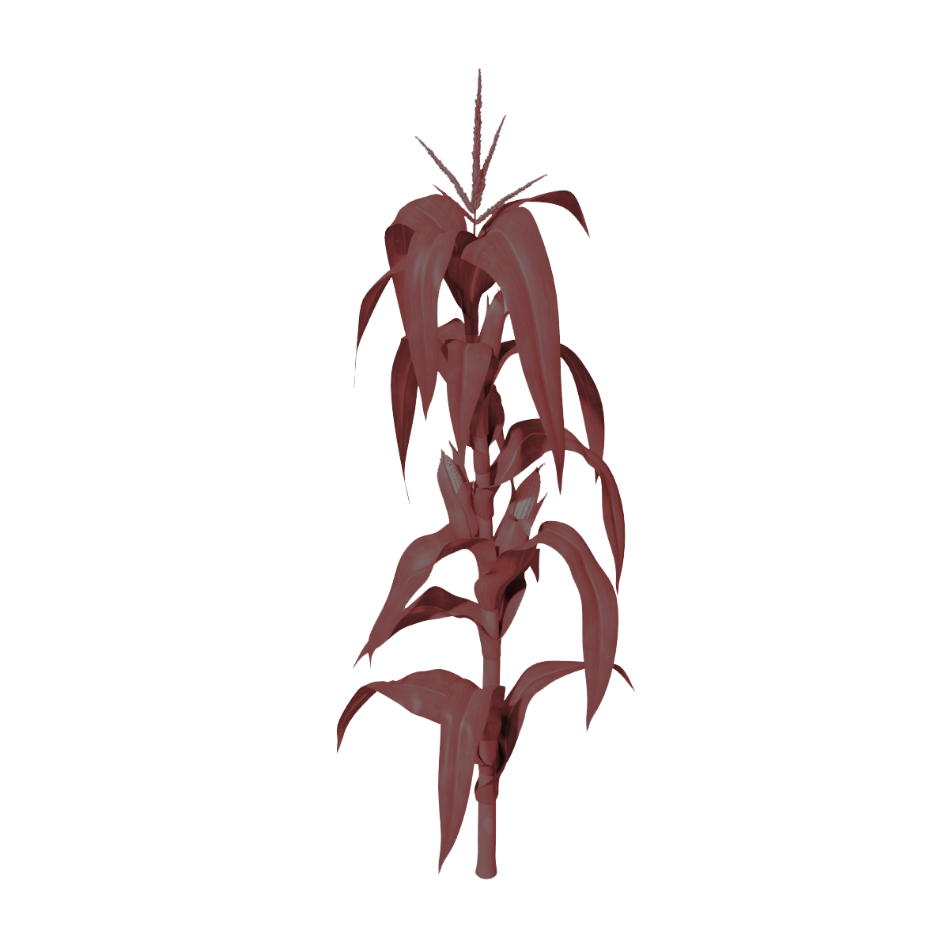
Haploids & Diploids
Diploids: Have two sets of chromosomes (2n)
Haploids: Have one set of chromosomes (n)
Successful crossing if inducer color can be seen
2n
2n
n
“Mother”
Has desired
trait
“Fake Father”
Inducer Line
“Kicked out”
Holds desired trait
Very weak, won’t survive by itself
Notes:
Corn Plant: https://www.pngmart.com/image/5226

Slide 11
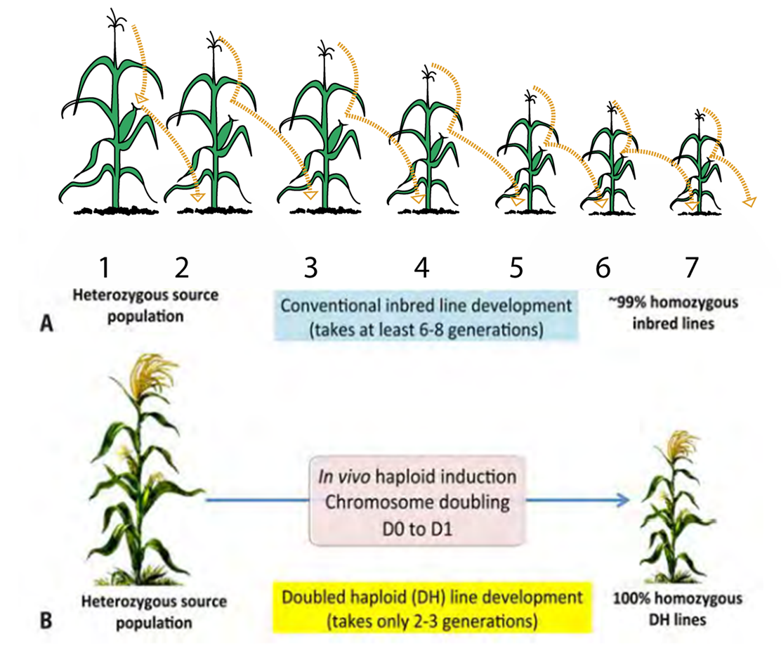
Double Haploids: Colchicine & SHGD
2
n
DH
Haploid
*Very weak, won’t survive by itself
Double Haploid
*Vigorous, performs well by itself
Colchicine: treatment that doubles the haploid; very toxic
Spontaneous Haploid Genome Doubling: natural gene that automatically doubles the haploid
Notes:
Corn Plant: https://www.pngmart.com/image/5226
Inbred Line vs Double Haploid: https://repository.cimmyt.org/xmlui/bitstream/handle/10883/1351/97066.pdf

Slide 12
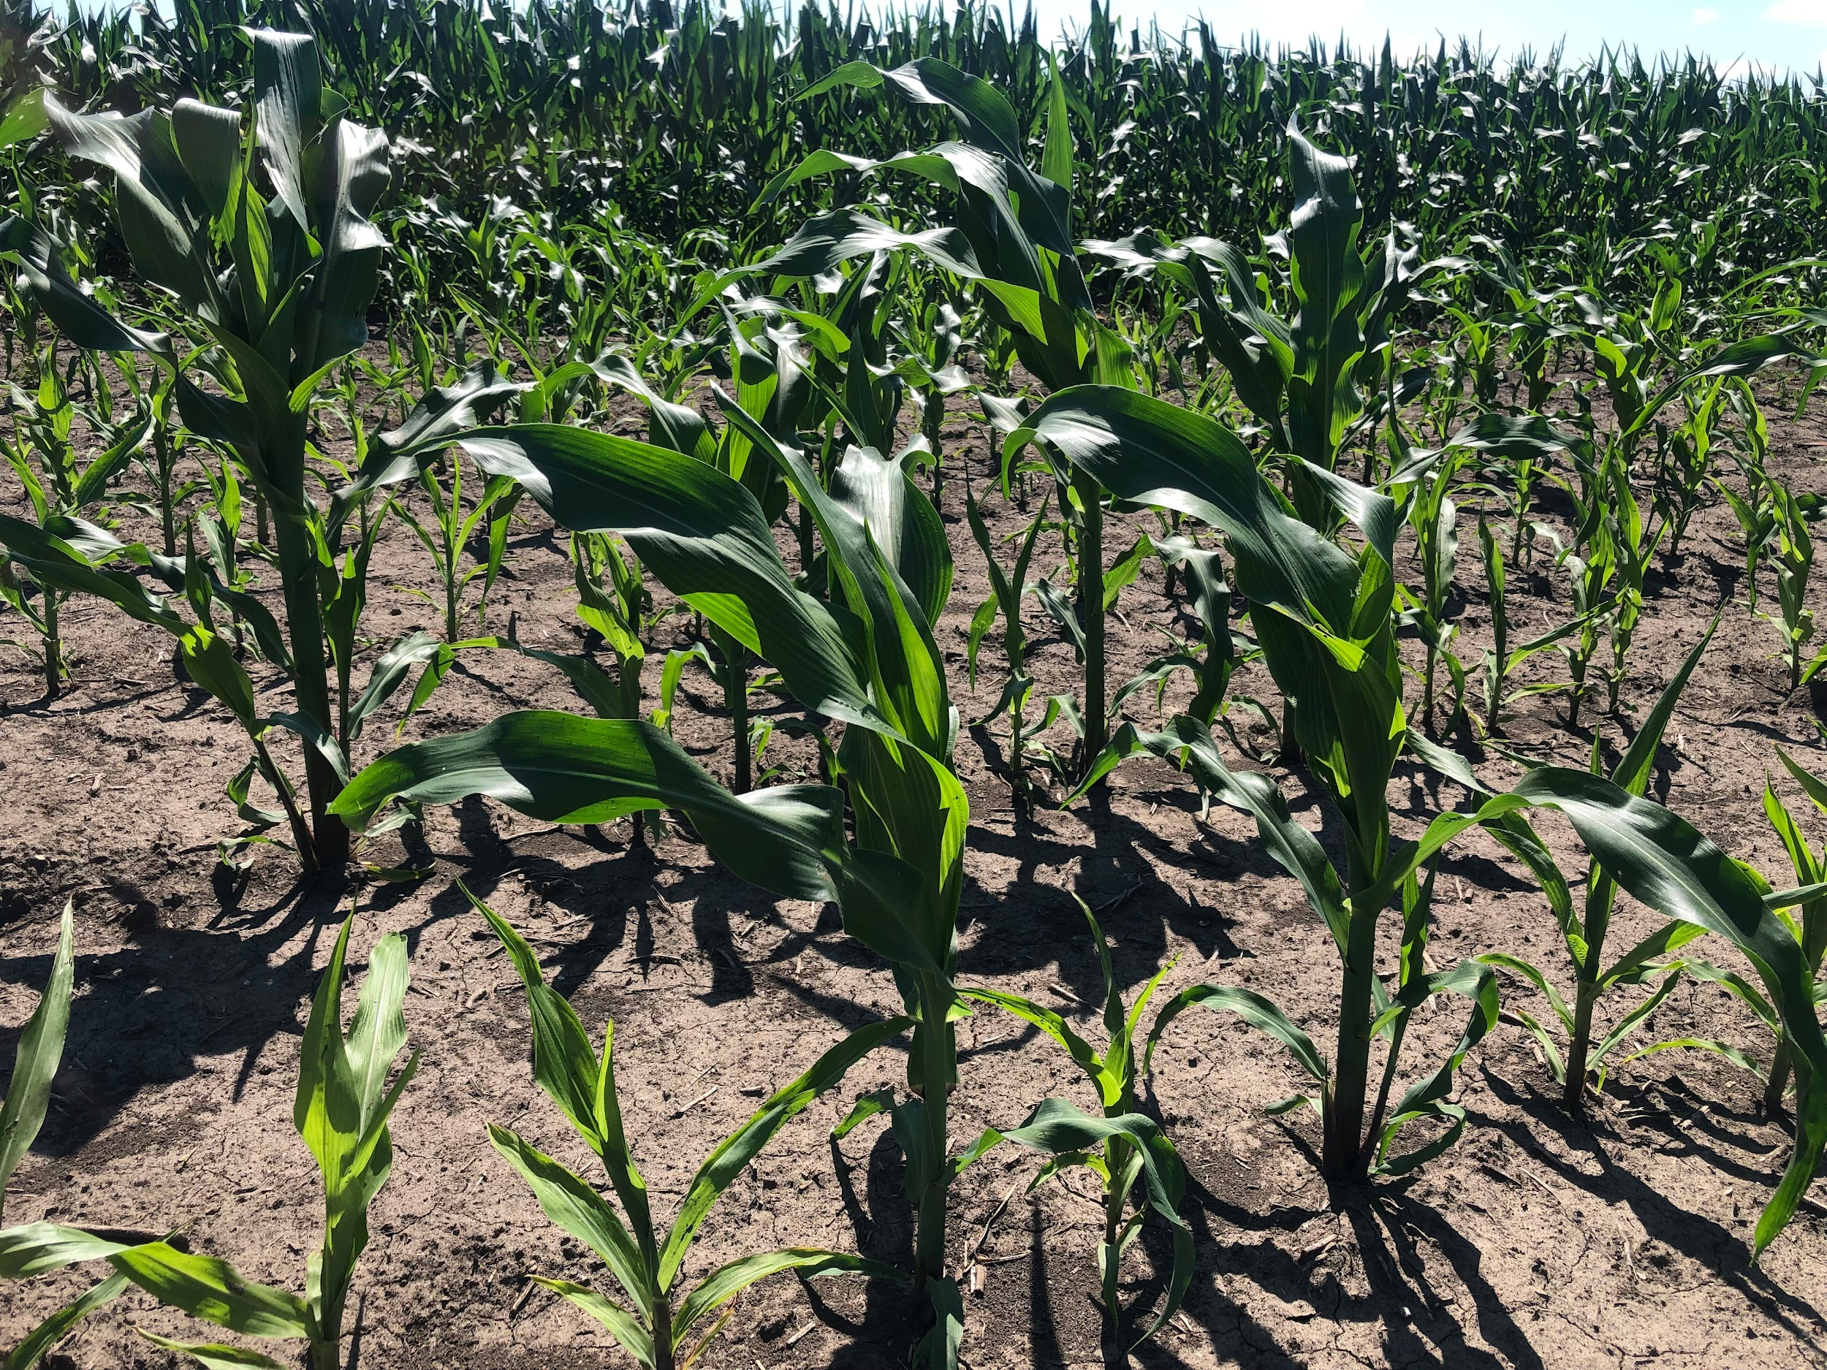
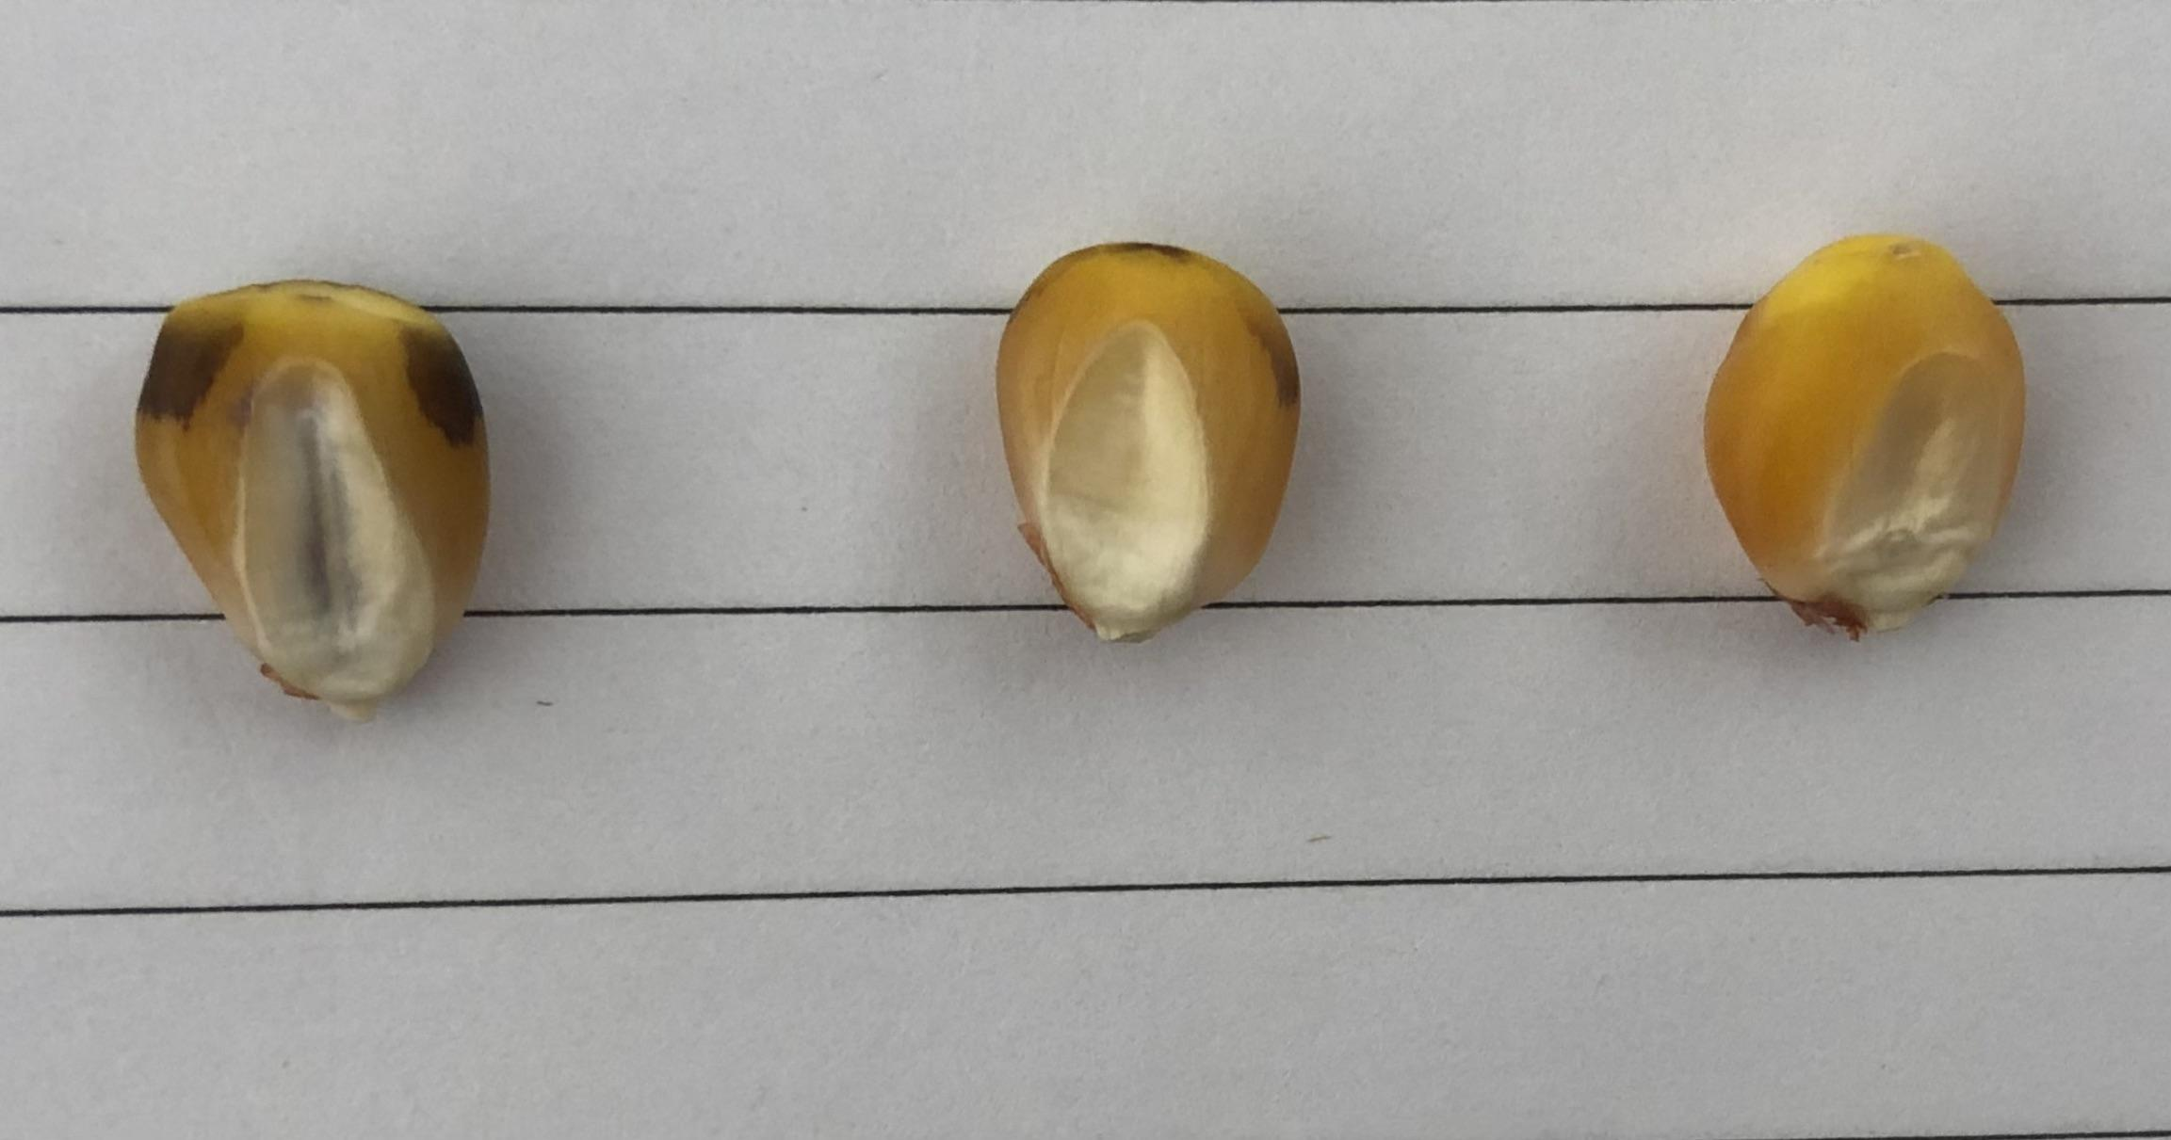
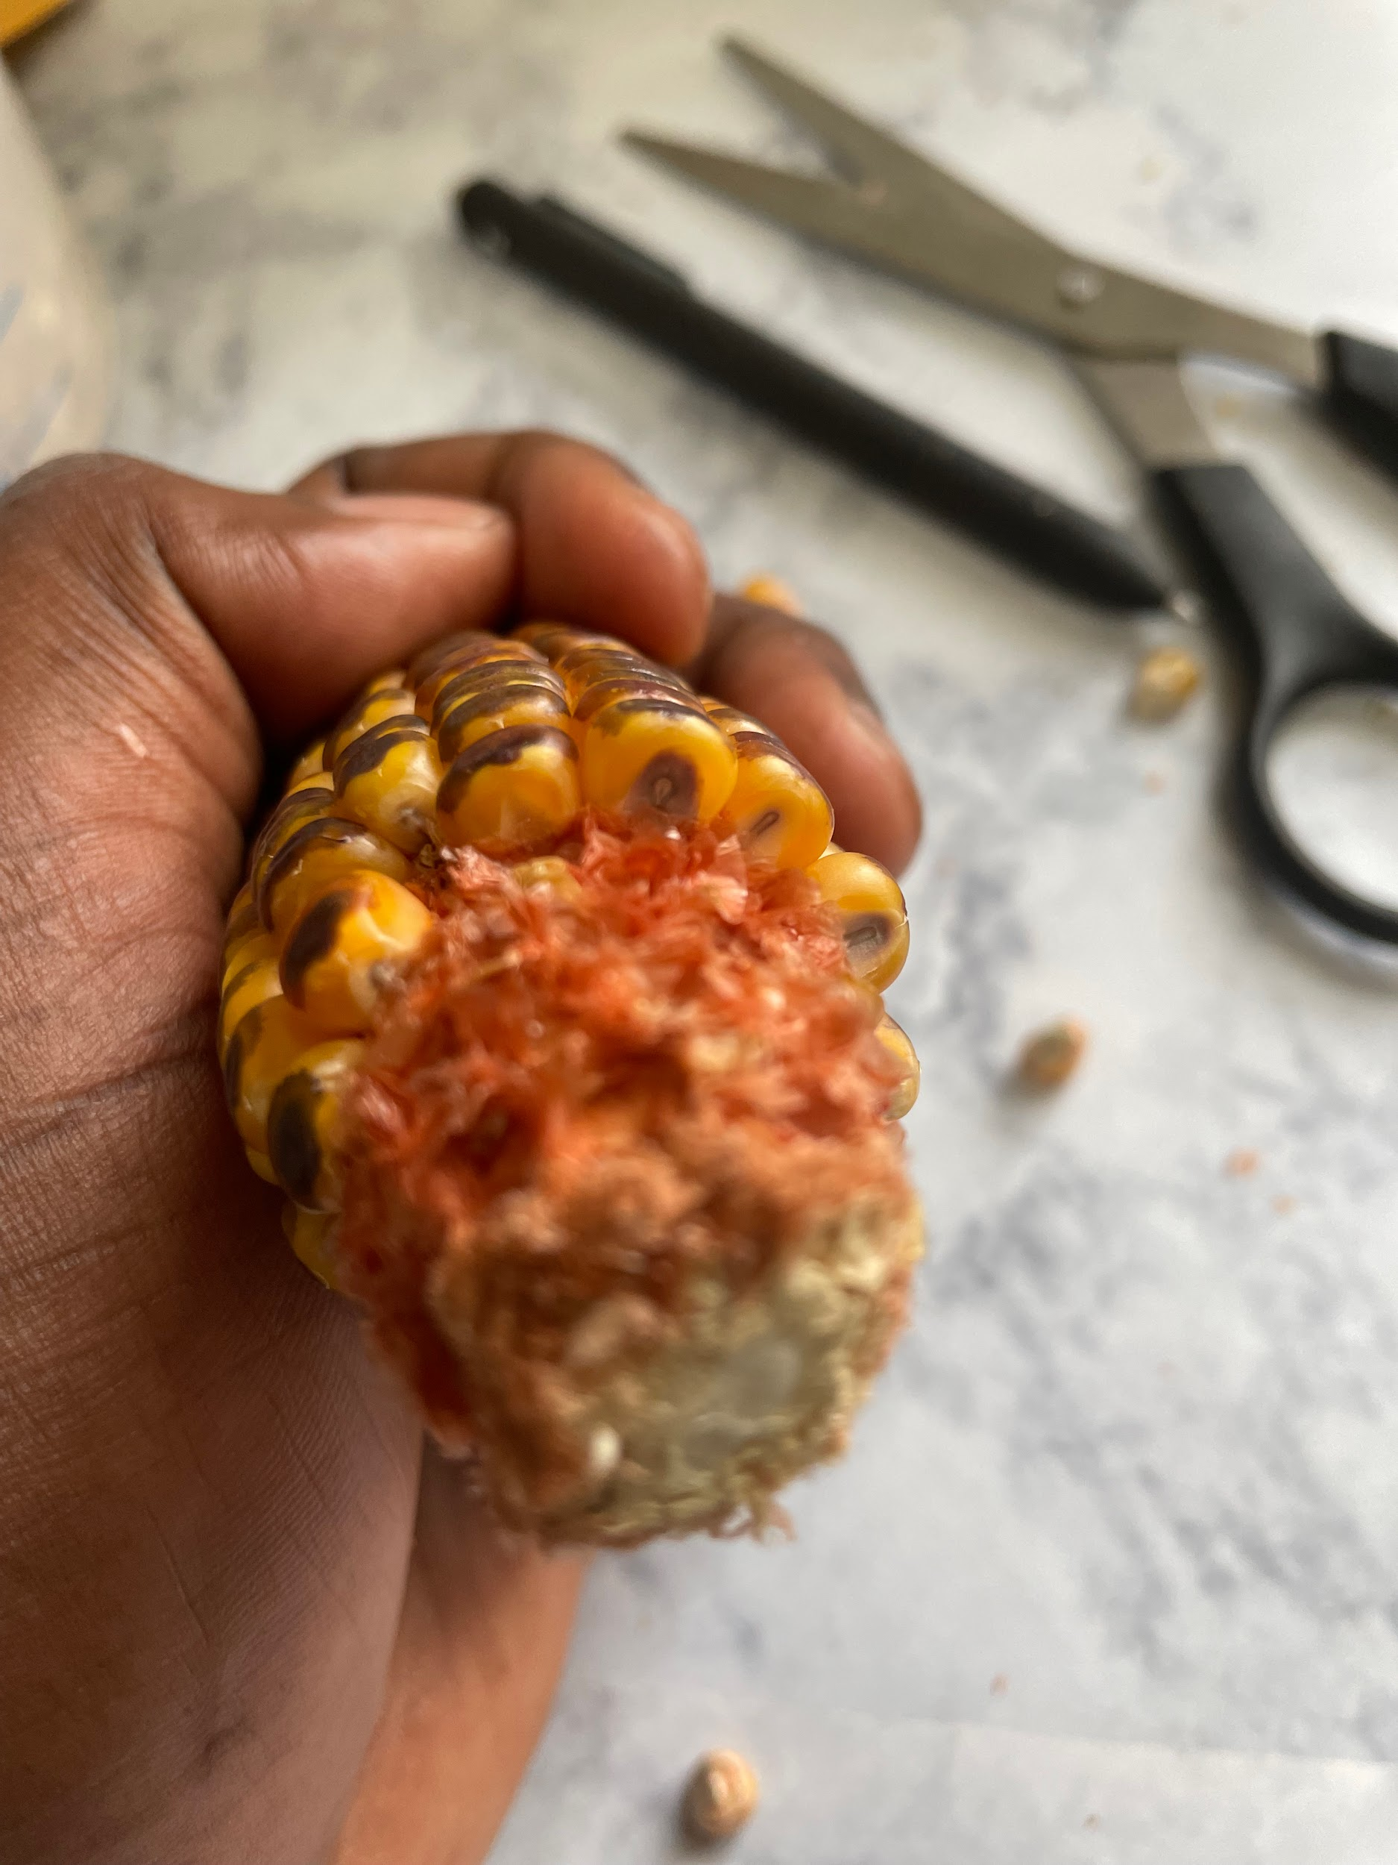
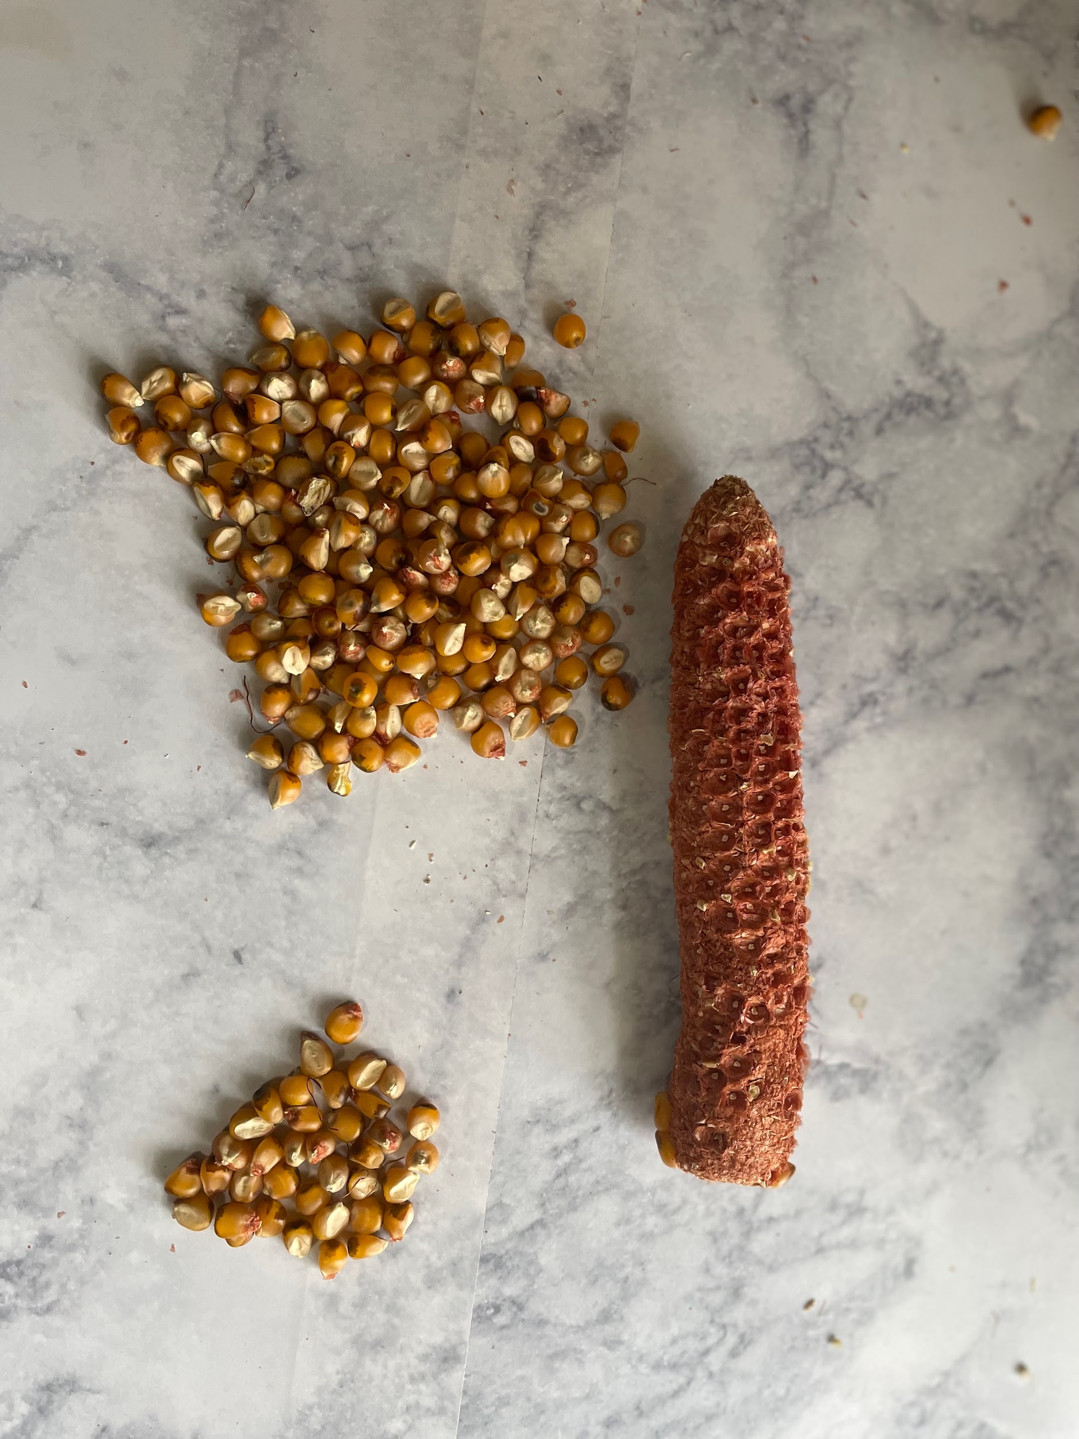
Pictures of Haploids, Diploids & Contamination
Diploid
90%
Haploid
10%
Contamination
Haploid Diploid

Slide 13
Phenotyping and Data Collection

Slide 14
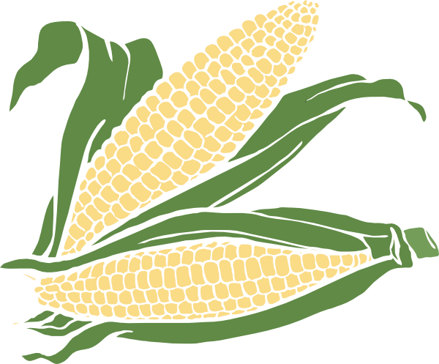
Phenotyping and Data Collection
What is phenotyping?
Phenotyping is the observation of physical traits on any living organism.
What did we observe?
We measured the height of the corn plant from the bottom of the plant to the flag leaf. In addition to measuring the height of the entire corn plant, we also measured the height of the first ear. This was measured from 4 reps of the same hybrid.
Why did we measure this?
We conducted phenotyping because the height of entire corn plant and the ear height is positively correlated to the yield the corn plant will have. This exhibits the productivity of the plant ( corn) based on observable traits.
What will this help us understand about hybrids?
By seeing which hybrid had the highest heights we will predict which hybrid will be the most successful in yielding large amounts of corn.

Slide 15
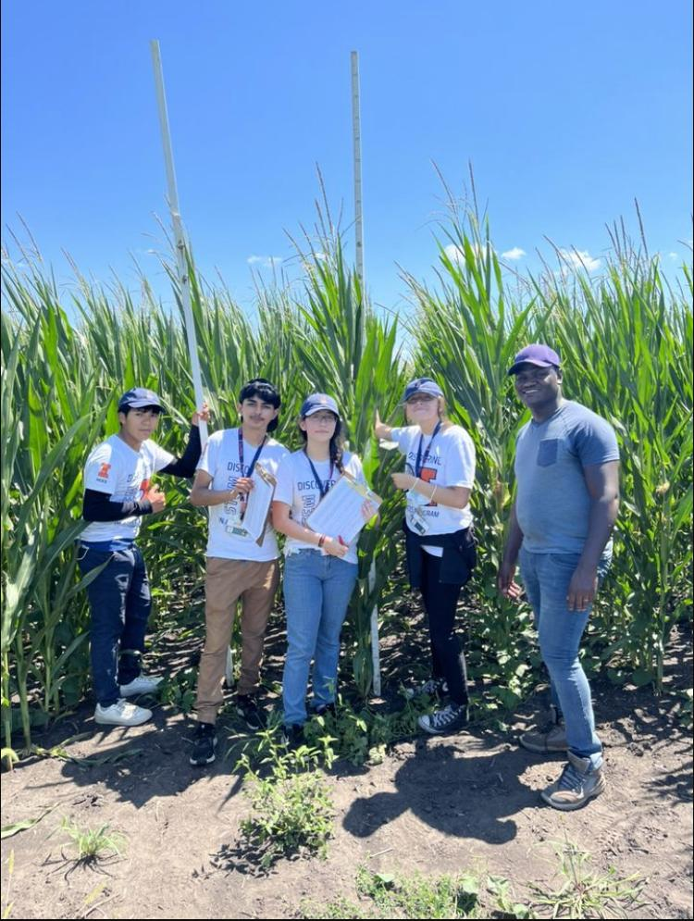
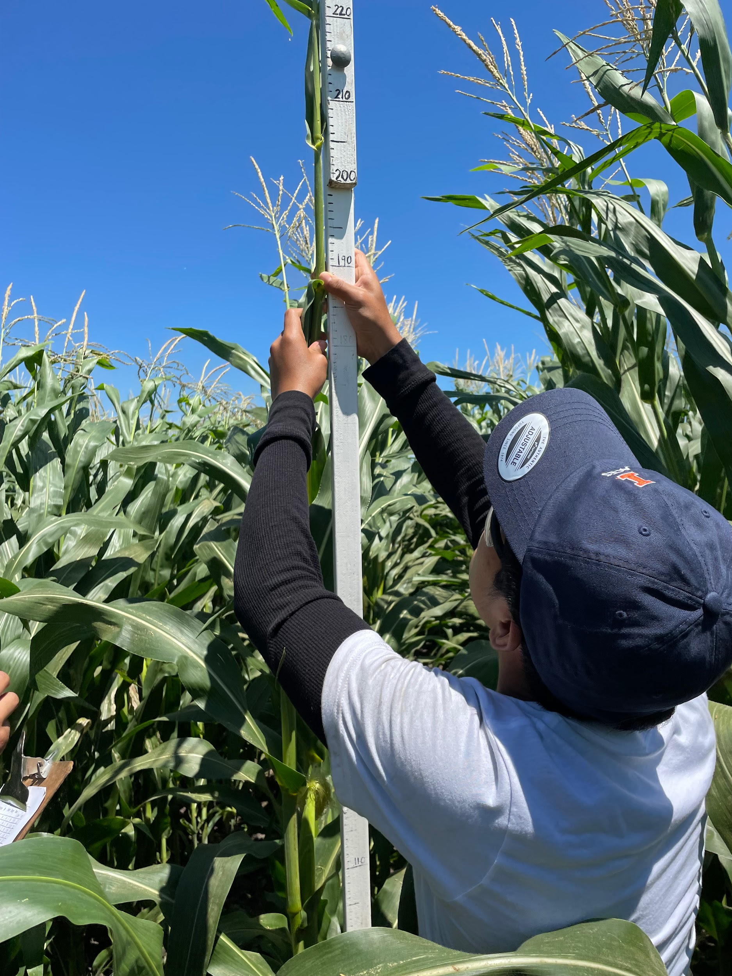
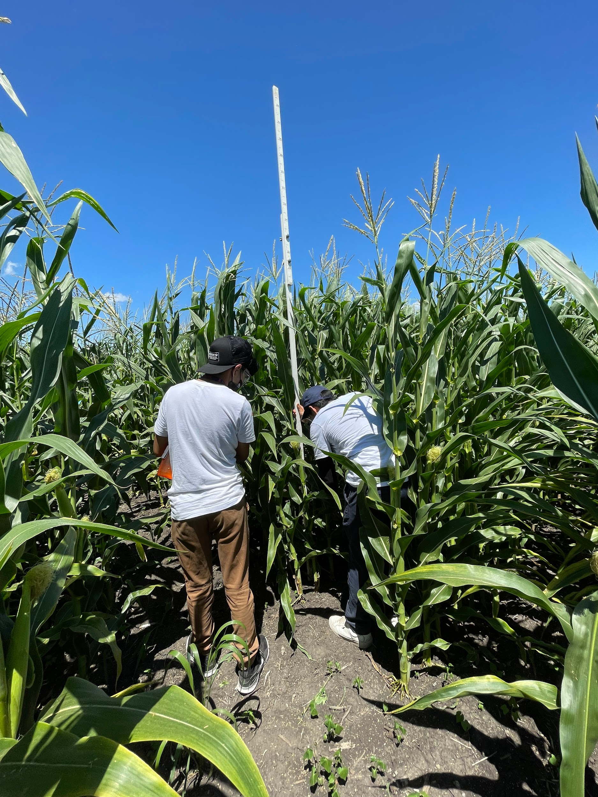
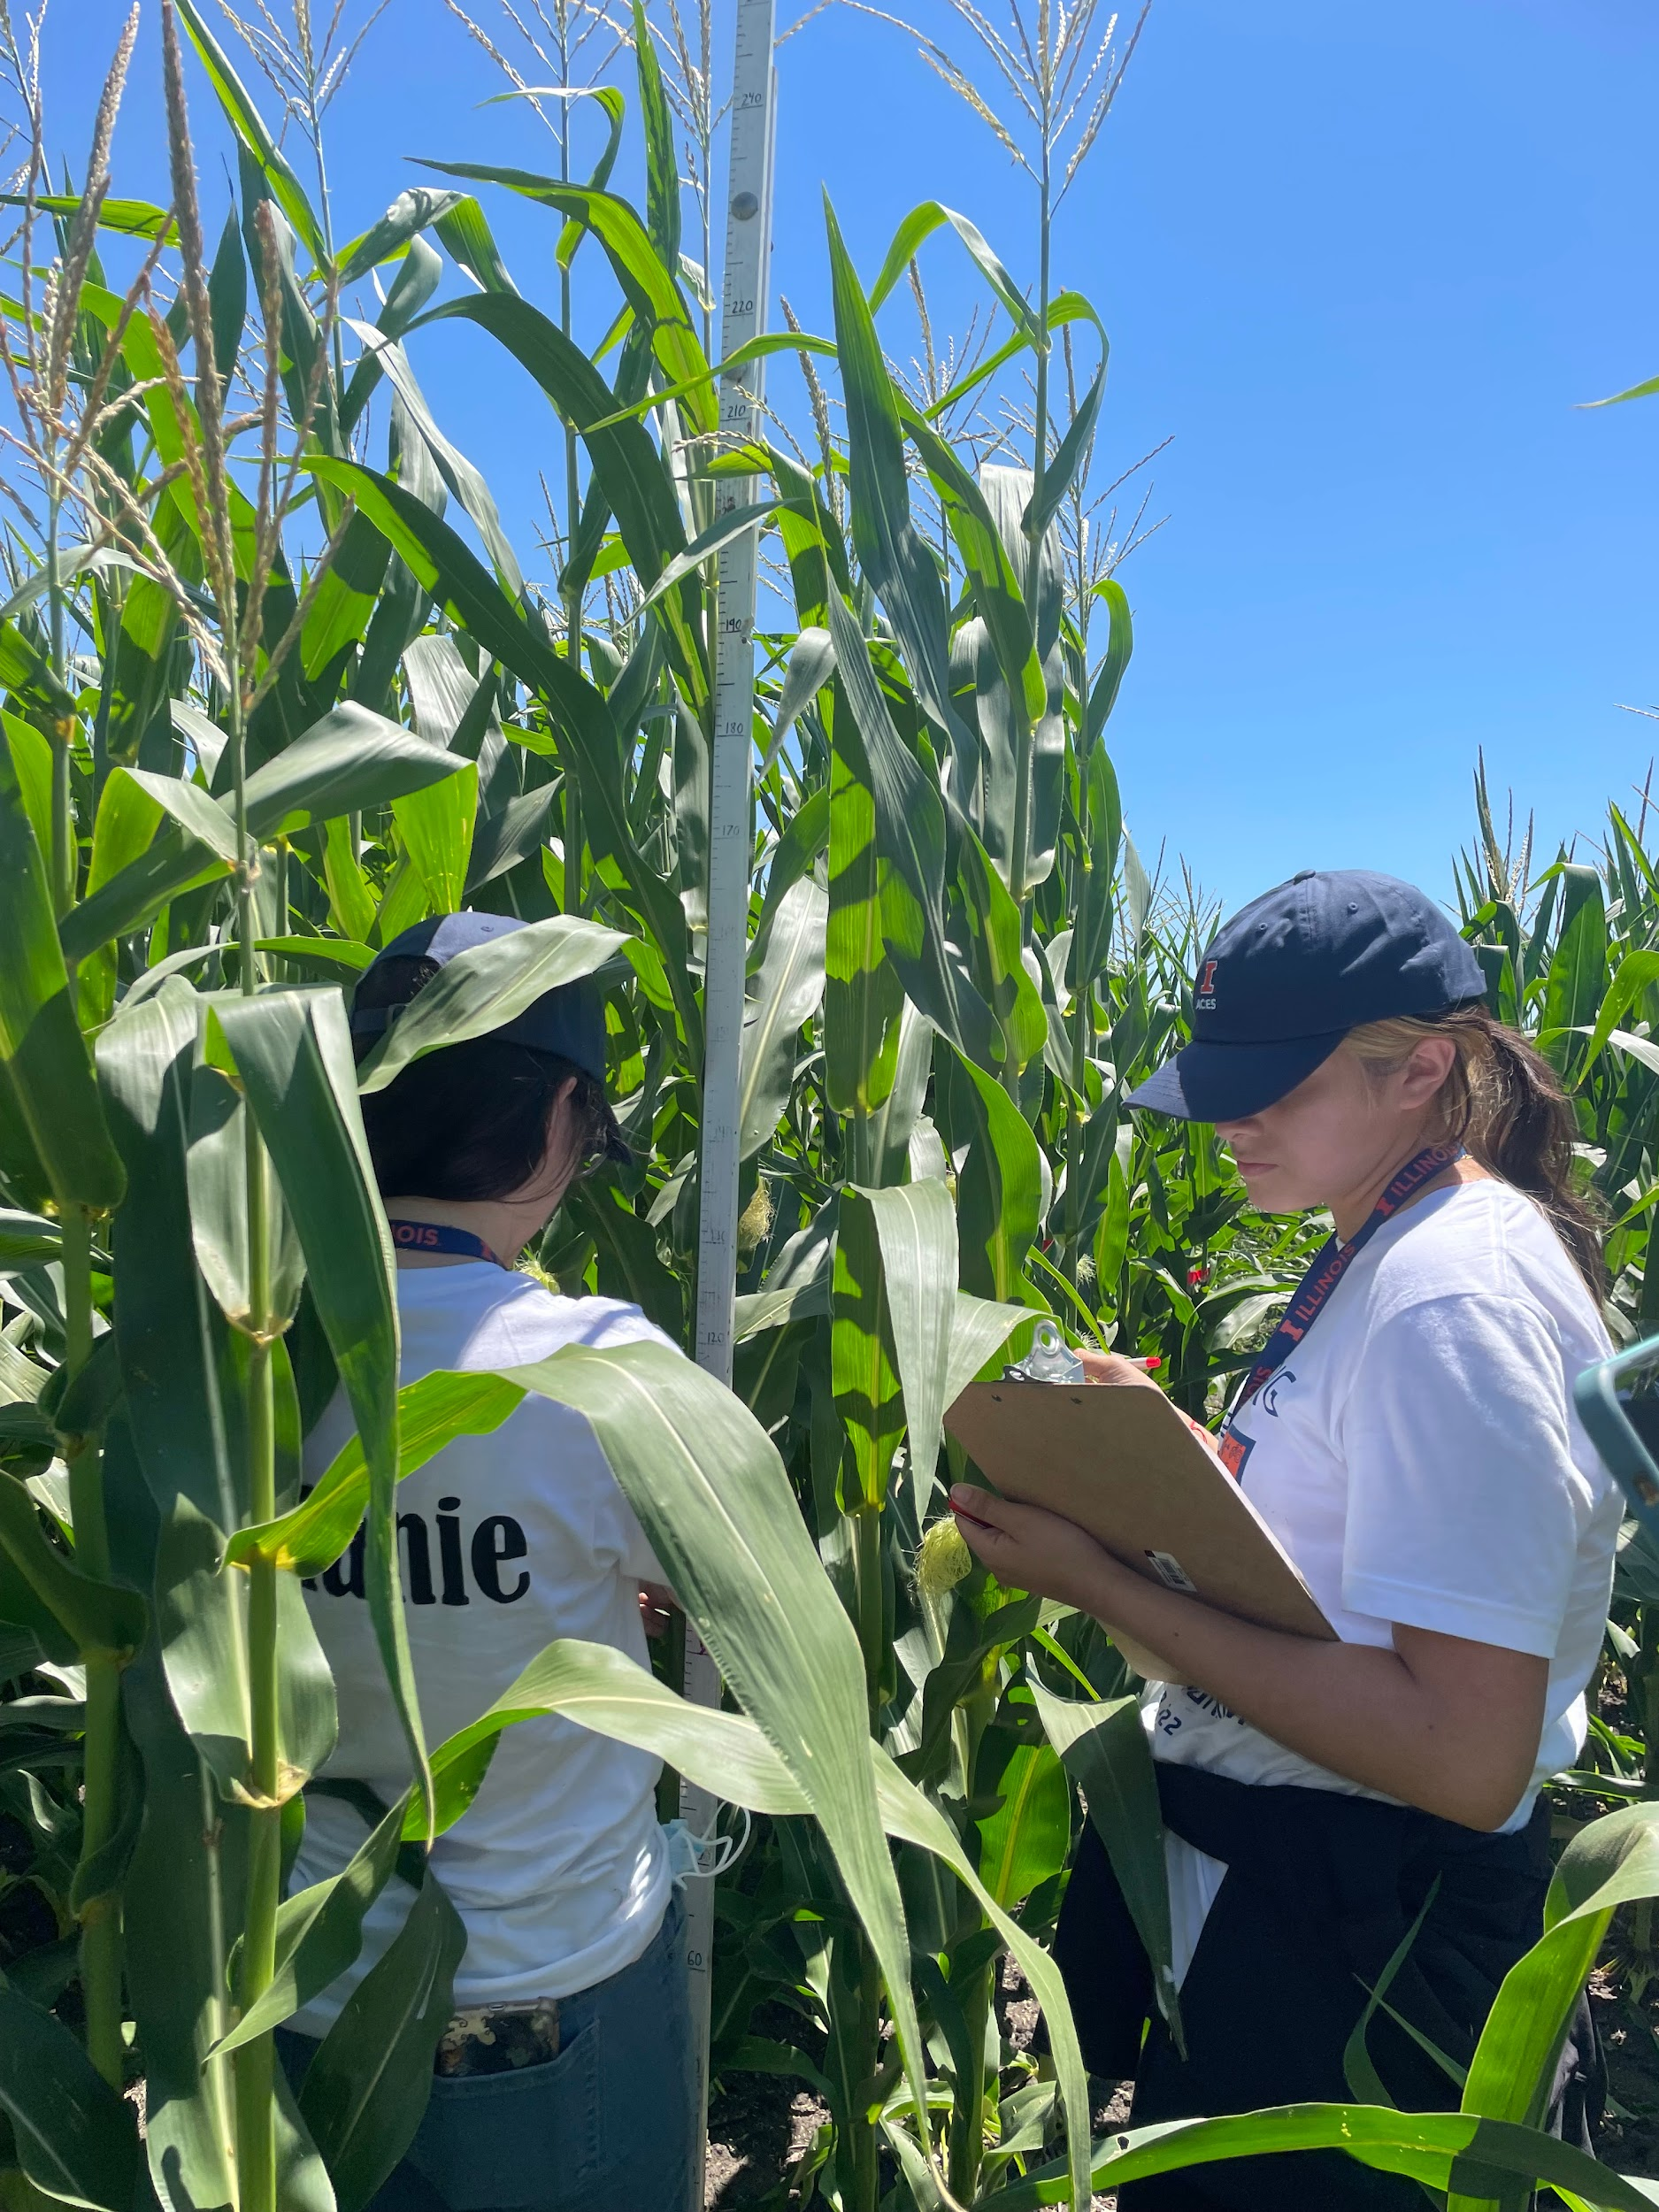
Phenotyping and Data Collection-Images
High Impact hybrid experiments
High impact hybrids were developed from the most influential inbred lines in the corn industry
22 high impact hybrids are evaluated
4 replications using a Randomized Complete Block Design (RCBD)

Slide 16

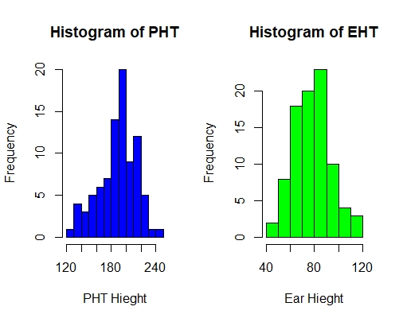
Data Management using Rstudio
RStudio is one of the statistical programs used in data science to analyse data
It allows you to write code to manipulate and analyze data.
We took the raw data collected for PHT & EHT, and transferred it into Rstudio.
We used plotted histogram and boxplots to visualize the variability in the data
Notes:
What hybrids we measure. We measure
Bell curve: lowest, middle and highest point
(PHT): plant height
(EHT): ear height
The plotted histogram allows to show the underlying frequency distribution ( shape) of continuous data.the lowest bars shows the least common range, the most frequent range are shown by the highest bar. The bell curve is shown throught the position and distribution of the data.

Slide 17
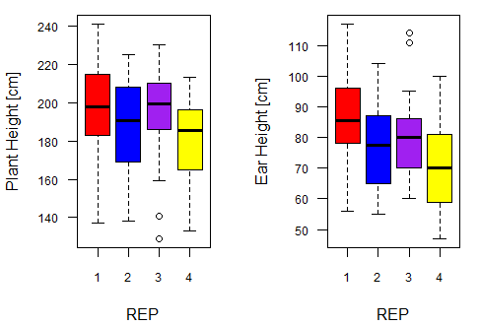
Mean of plant height and ear height from 4 reps
These graphs represent the mean heights for the ears and plants in each replication.
The thick black lines in the color block represent the mean
The two thin lines on the top and bottom of the color block represent the tallest and the shortest ear and plant of each rep (range/variation)
The two circles represent outliers in the reps
We are expecting the height to be similar because the same hybrids were planted. The mean for each rep are almost similar.

Slide 18
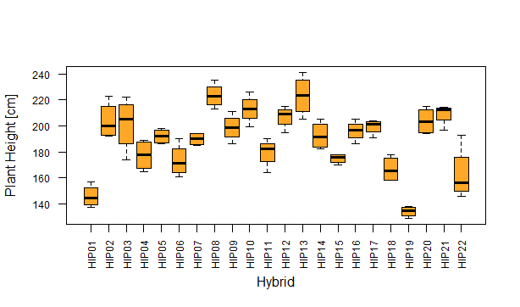
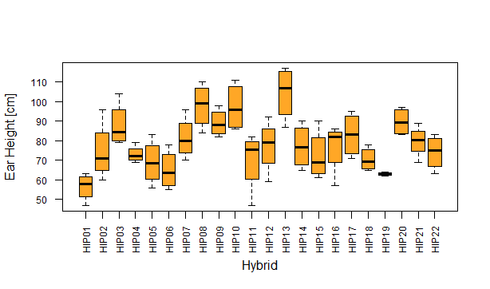
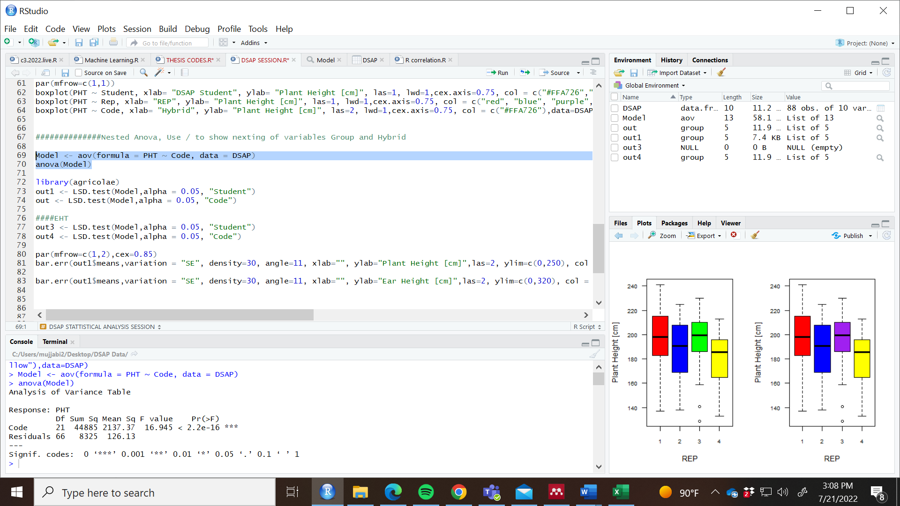
Box Plots (Variability between Hybrids)
Analysis of Variance (ANOVA)
We used a linear model regression model to conduct an analysis of variance (ANOVA)
The P values below 0.05 shows they are significantly different.
This tests for significant differences between the hybrids.
The value of P is significant as it shows there a significant different which illustrates the hybrid with he best performance
Notes:
How each hybrid is, max and min range. The value variability of each hybrid. Took the 4 values and plug it in into a box plot. Doesnt really show they are significantly different. : whats the range between these values? Close or far apart?
Based on what we see , theres some differences between the hybrid. The P value is significant meaning there a significant difference.
Box plot; the variability in performance, the means are higer , plant 19 is struggling
Statistically they arent much different and through the use of a linear model ( analysis of variance) to test of statistical difference. The P values if they are below 0.05 it shows they are significantly differently.
Through the use of box plots we are able to display and identify
Box plots; variability of heights
Analysis of variants
( plants with highest height has the highest ear high except for 2
Identify best performance

Slide 19
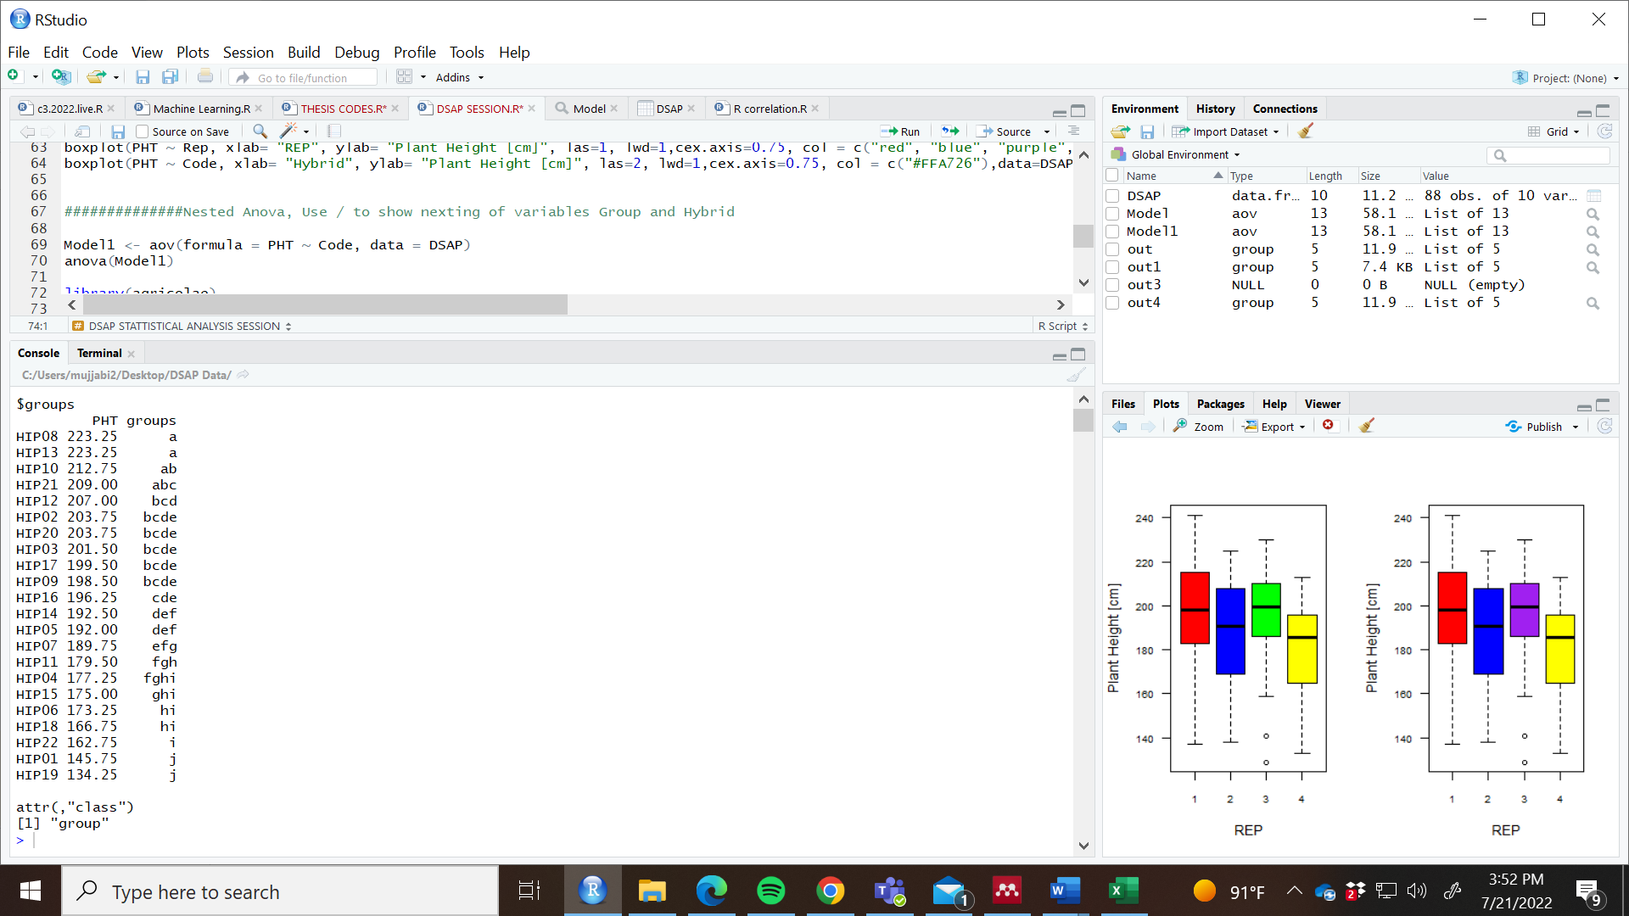
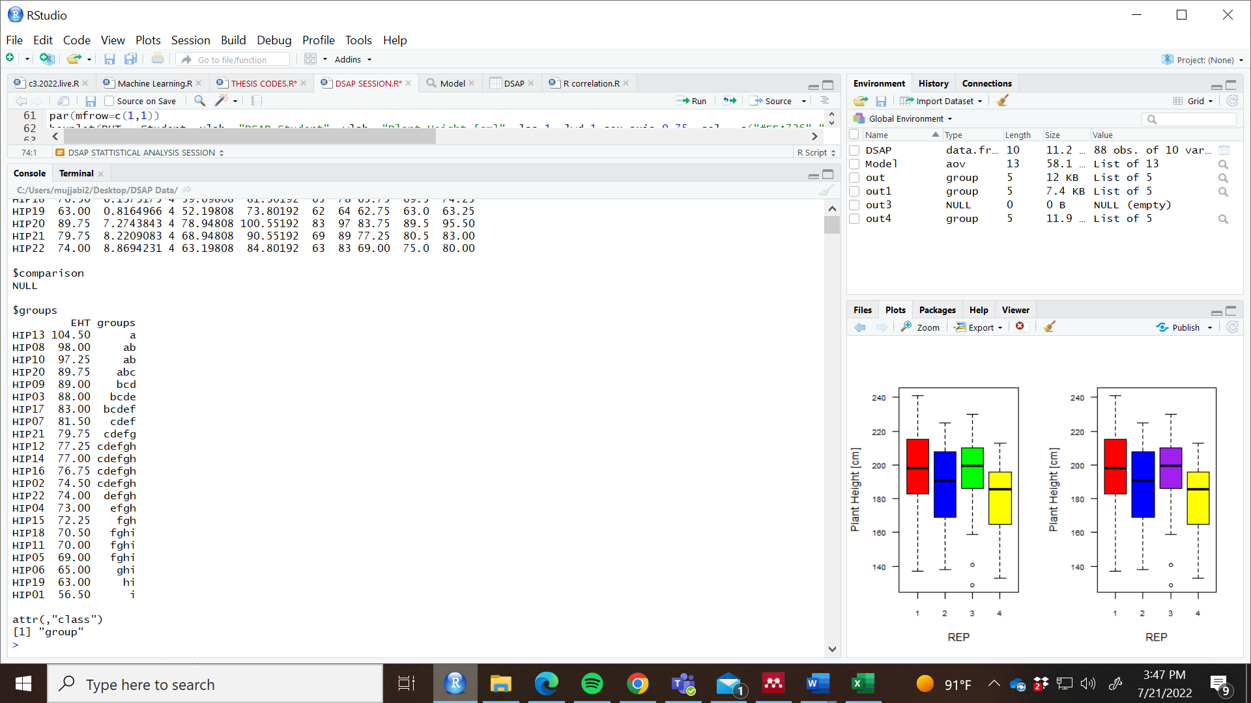
Pairwise Mean Comparisons
*Hybrids with a different letter are significantly different
Plant Height- Hybrids 8, 13, 10, and 21 are the same.
Ear Height- Hybrids 13, 8, 10, and 20 are the same.
but significantly different from the rest.
HIP08 = B73 x PHZ51
HIP13 = Tx714 x PHZ51
The best performers share a similar parental line
Notes:
Hybrid same letters: similar
Hyrbiuds with different letters are significant different. Higher hights

Slide 20
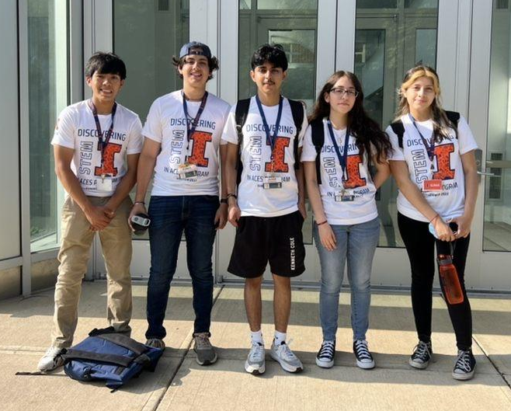
Thank You

